Slide 1
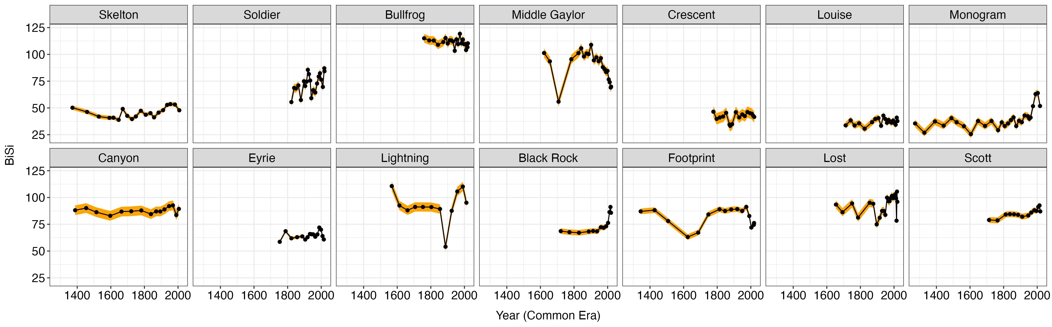
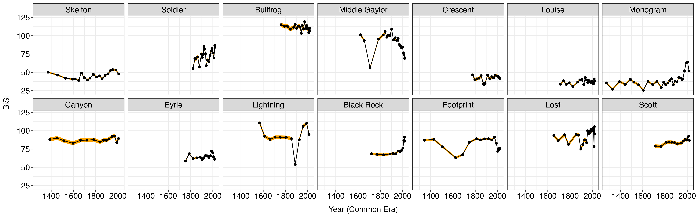
BiSi

Slide 2
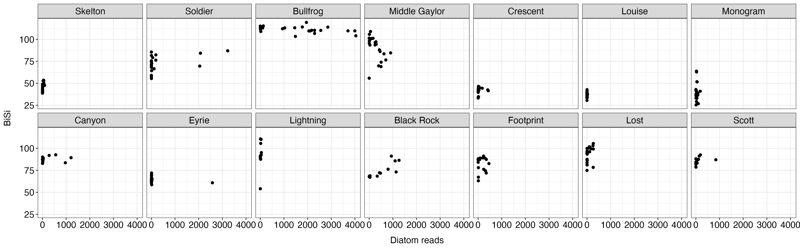
BiSi ~ diatom abundances

Slide 3
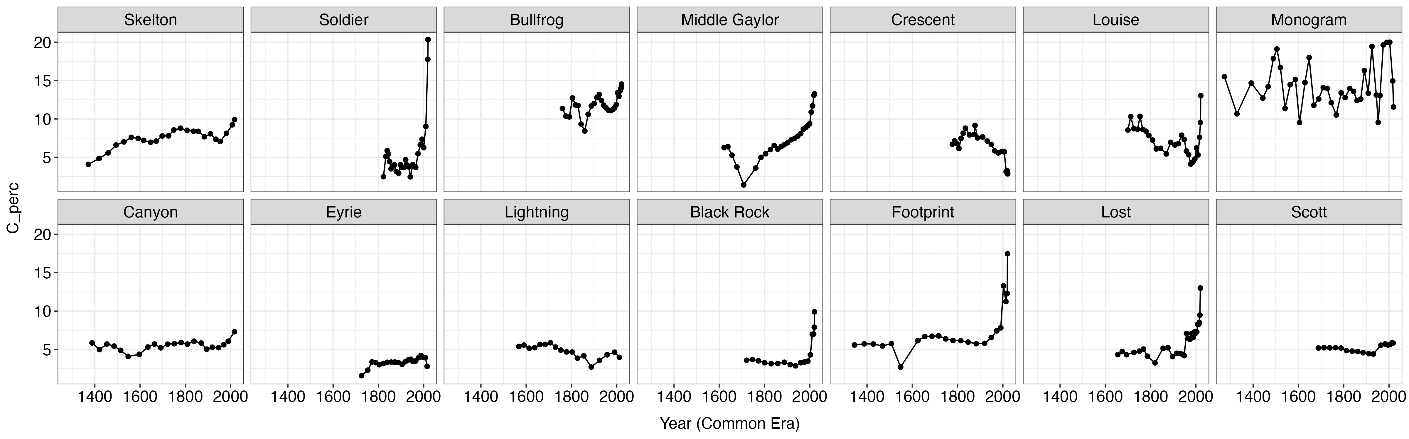
% carbon

Slide 4
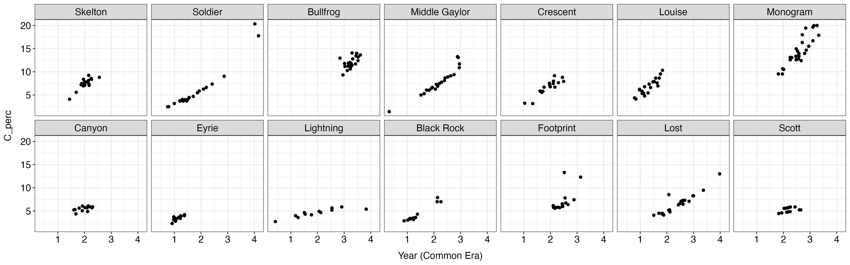
% carbon ~ C-H

Slide 5
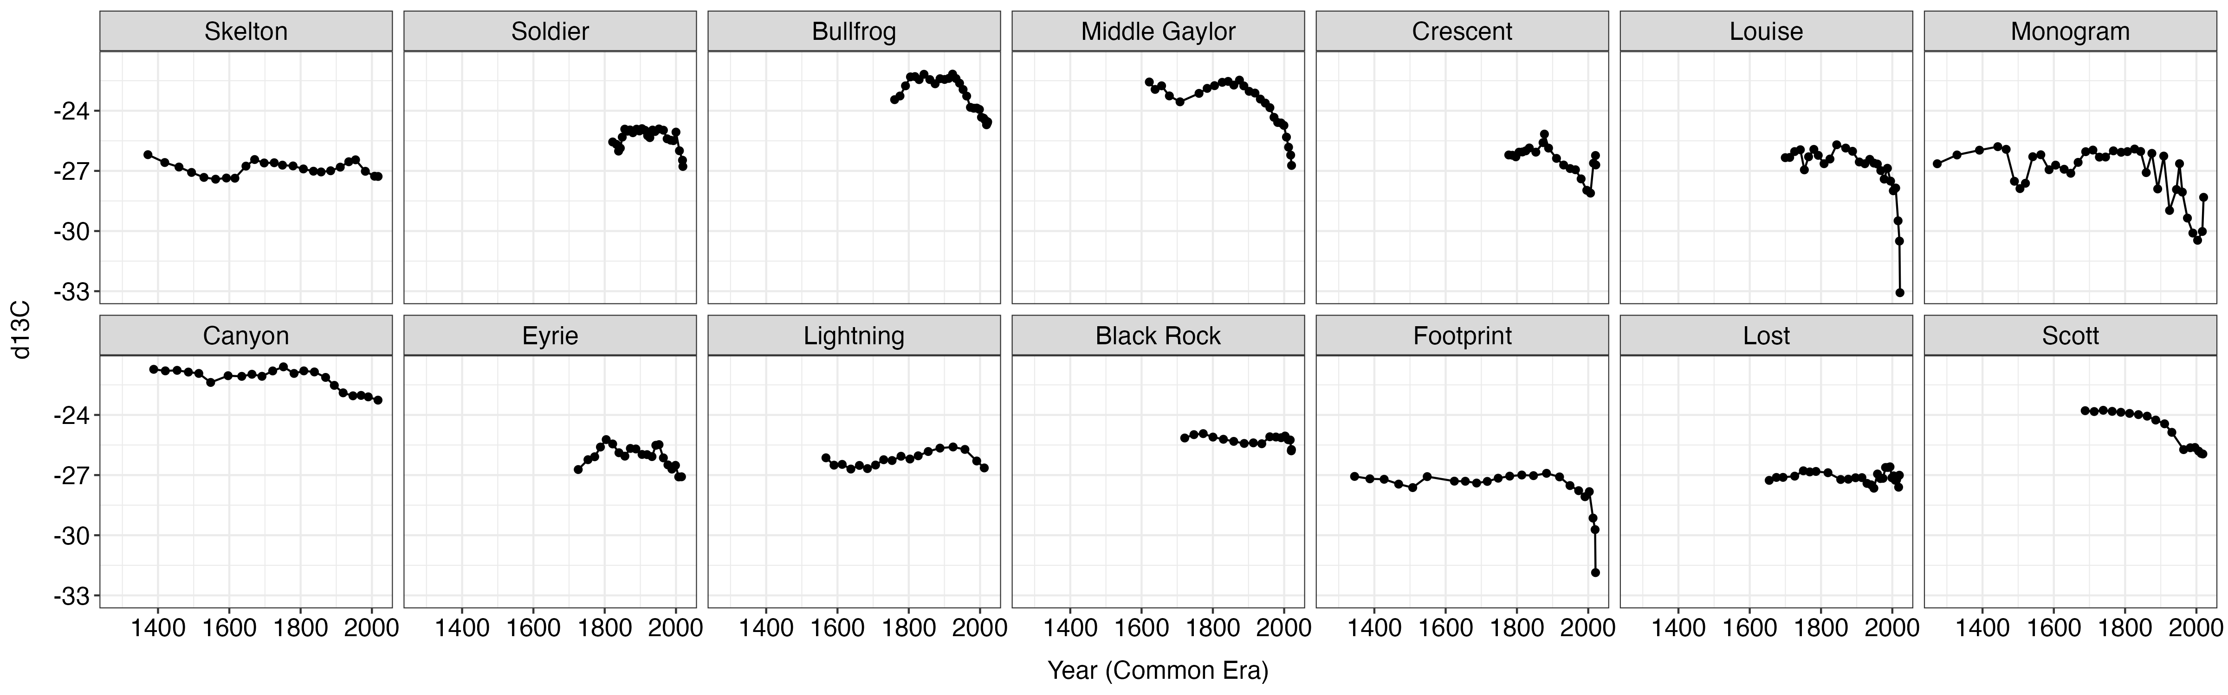
d13C

Slide 6
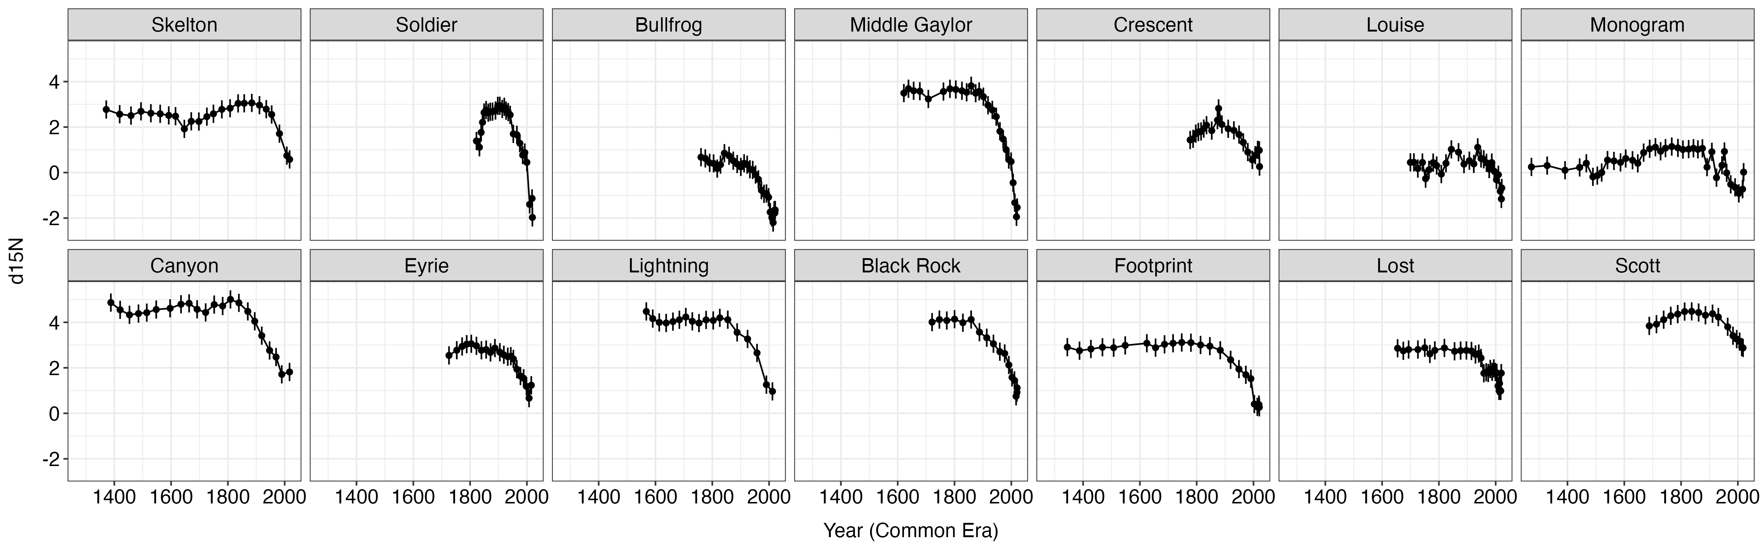
d15N

Slide 7
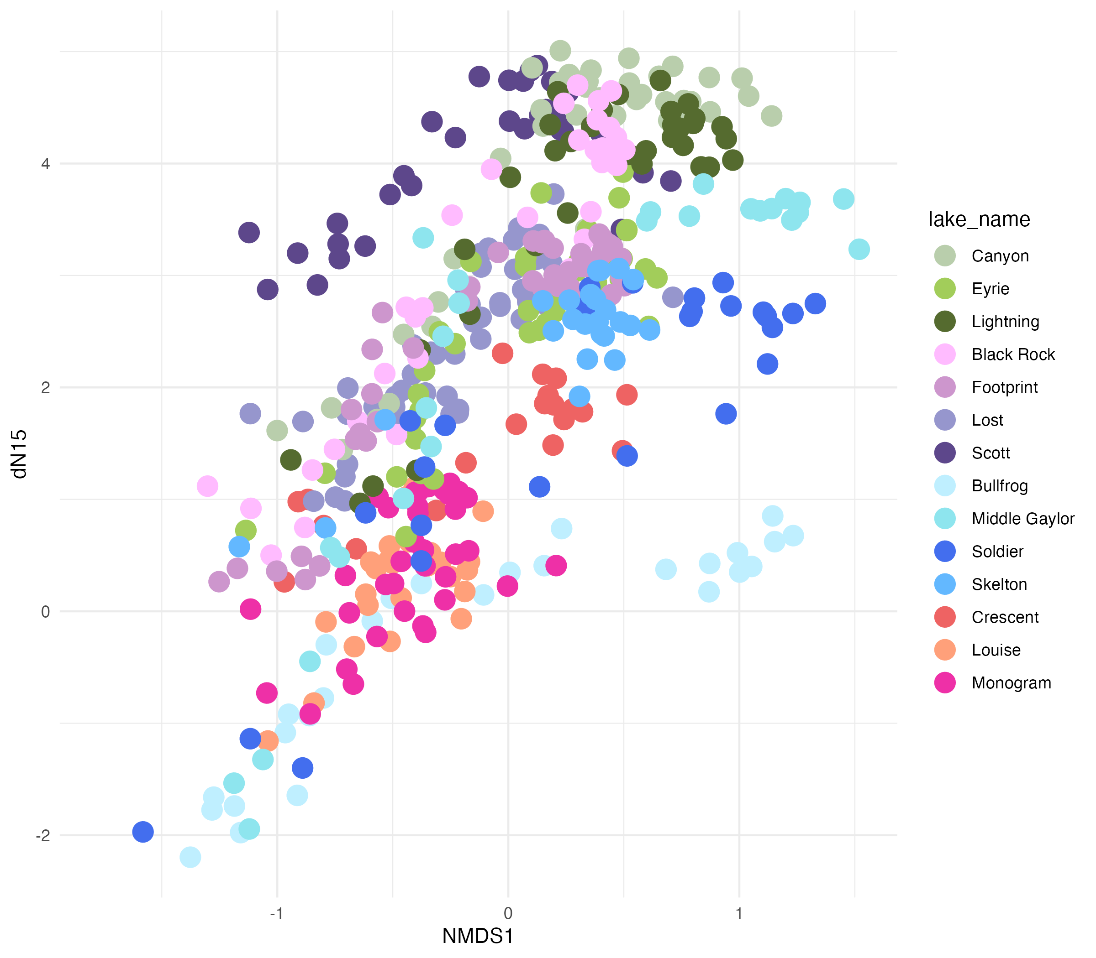
d15N ~ NMDS1 for V7 phytoplankton and zooplankton

Slide 8
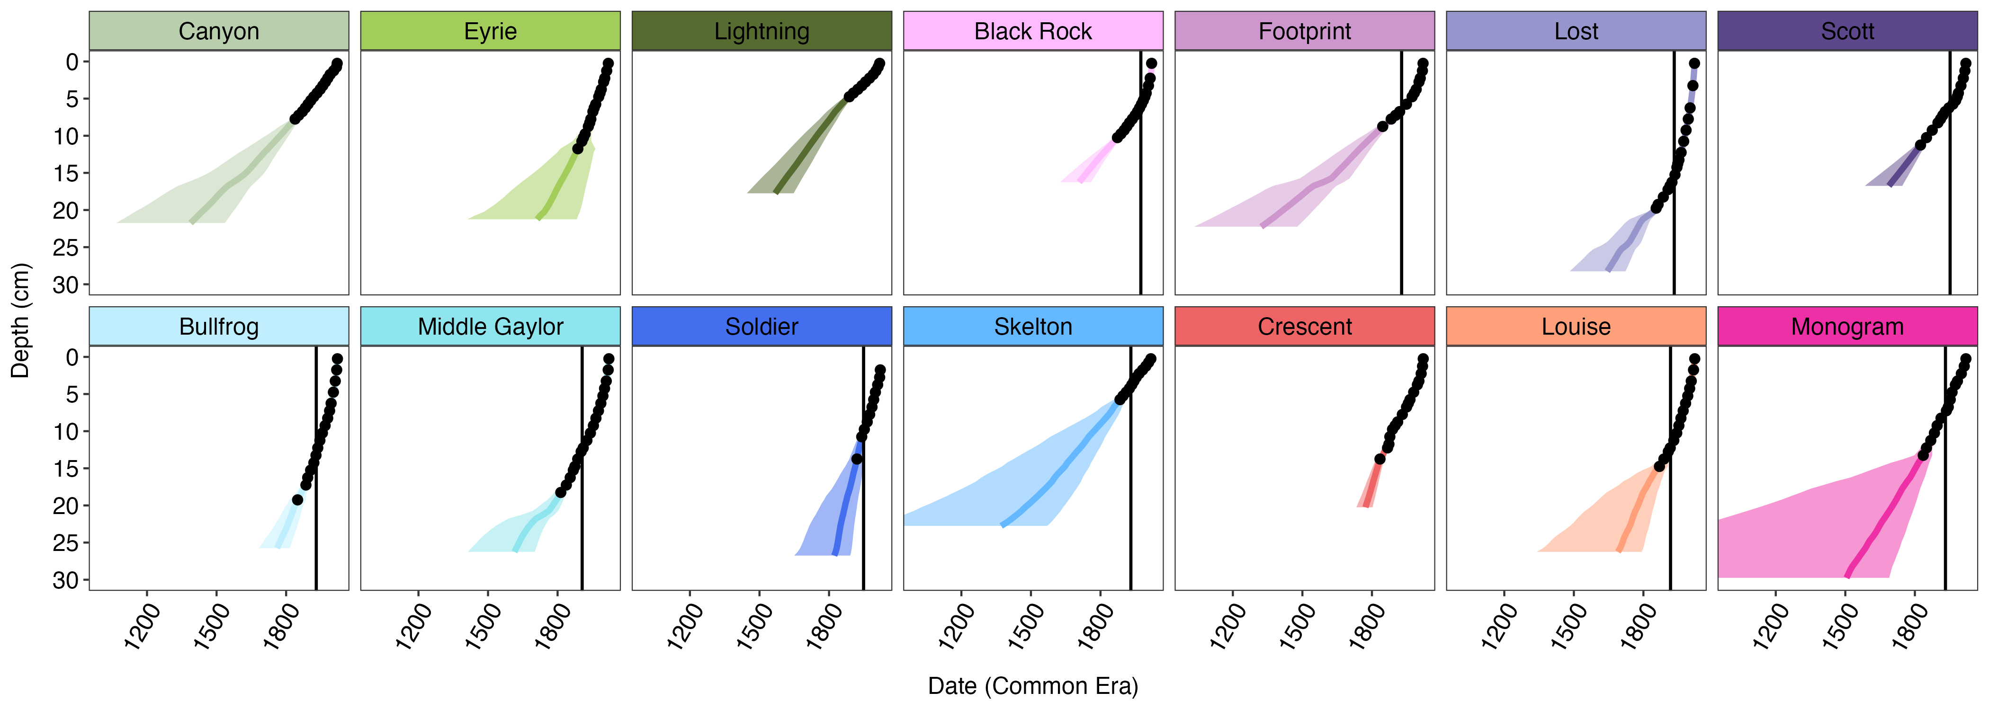

Slide 9
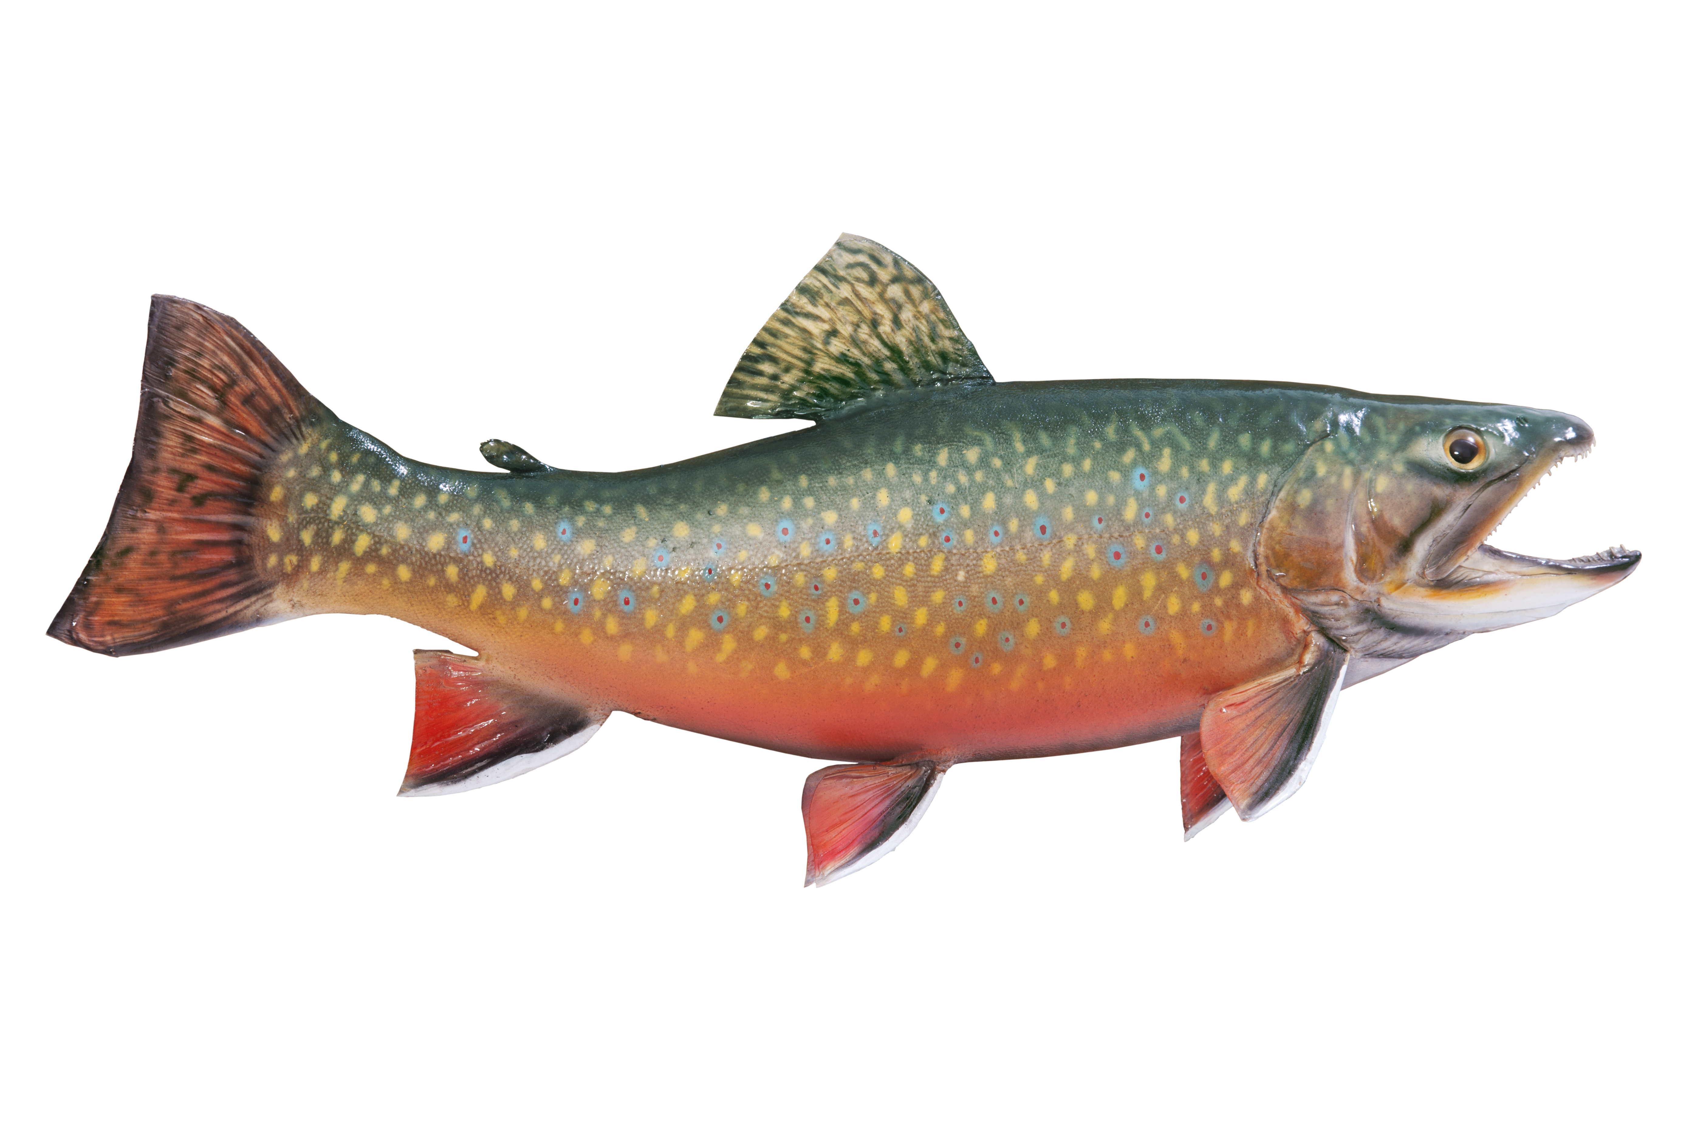
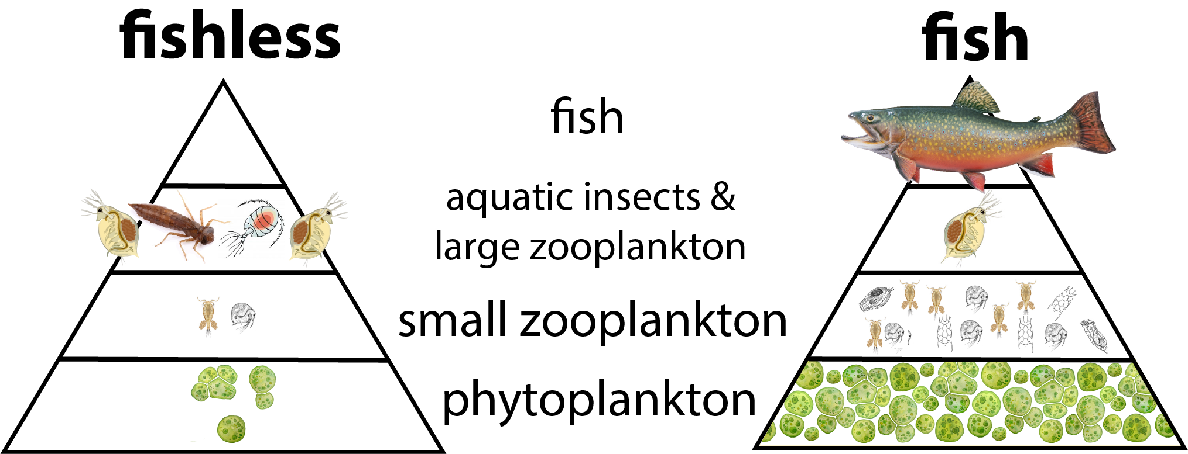
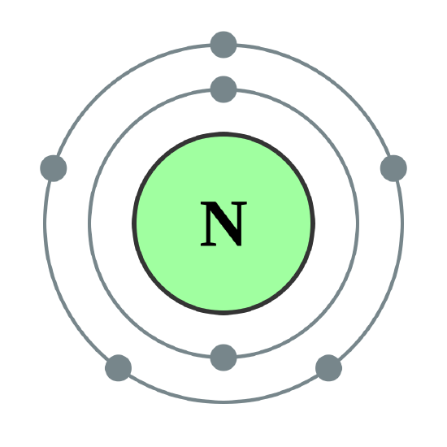

Fish
Fishless
Present
Past
?
Present
Past

Slide 10
Fish
Fishless
Present
Past
Present
Past
Present
Past

Slide 11
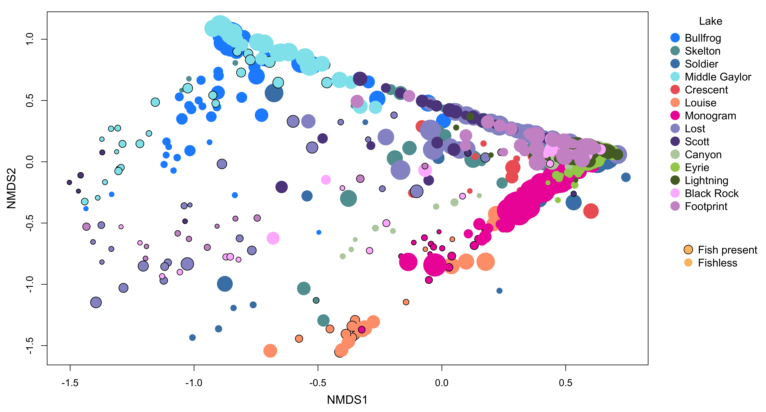
V7 Zooplankton – genus – all

Slide 12
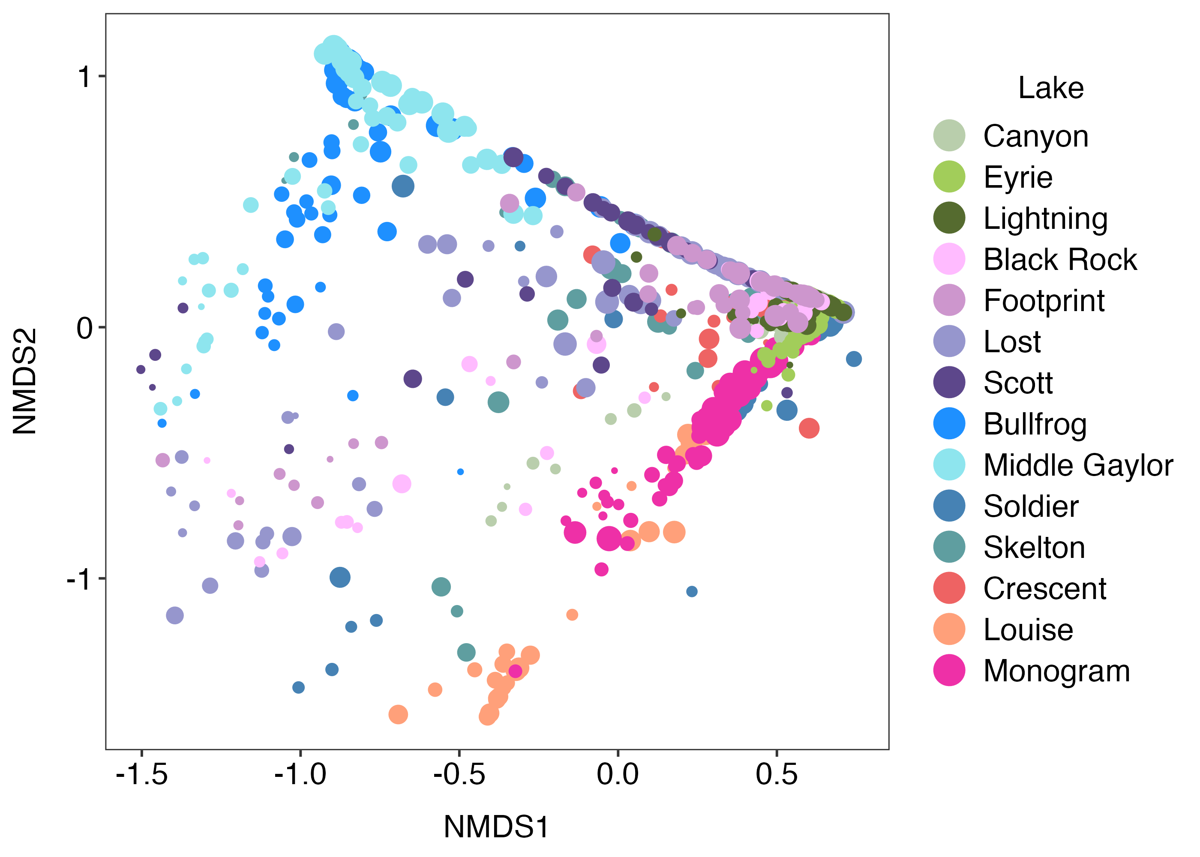
V7 Zooplankton – genus – all

Slide 13
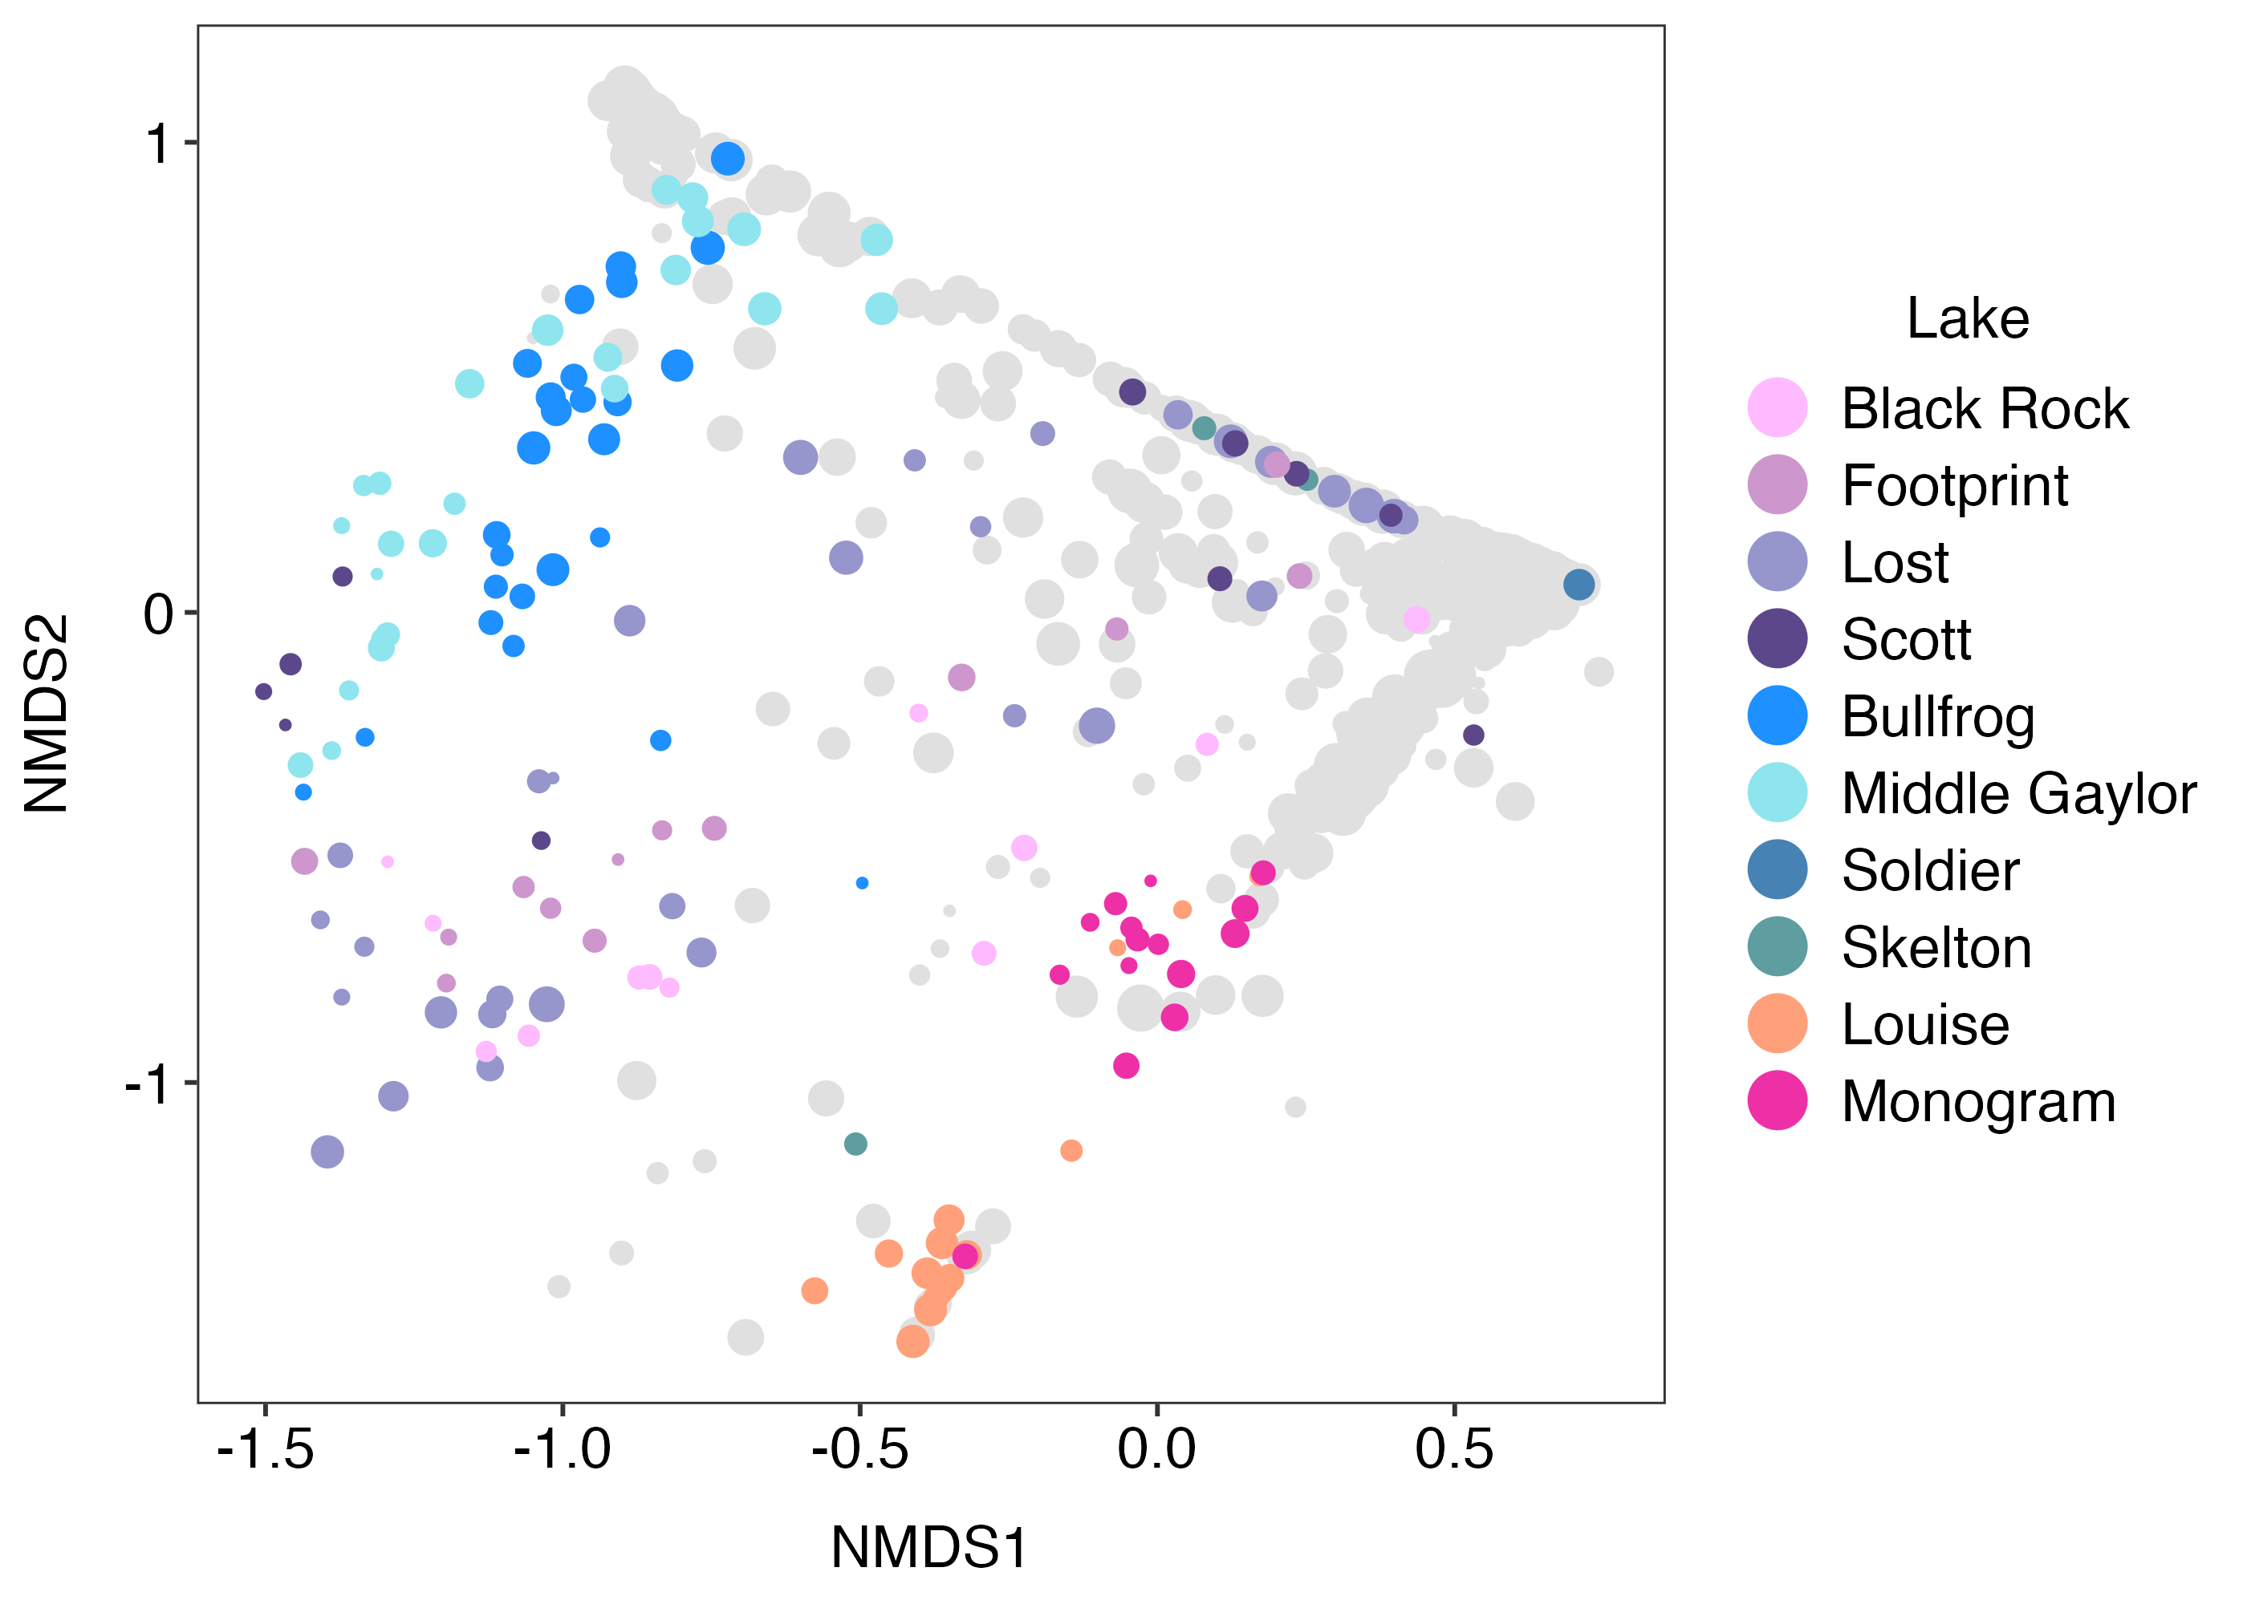
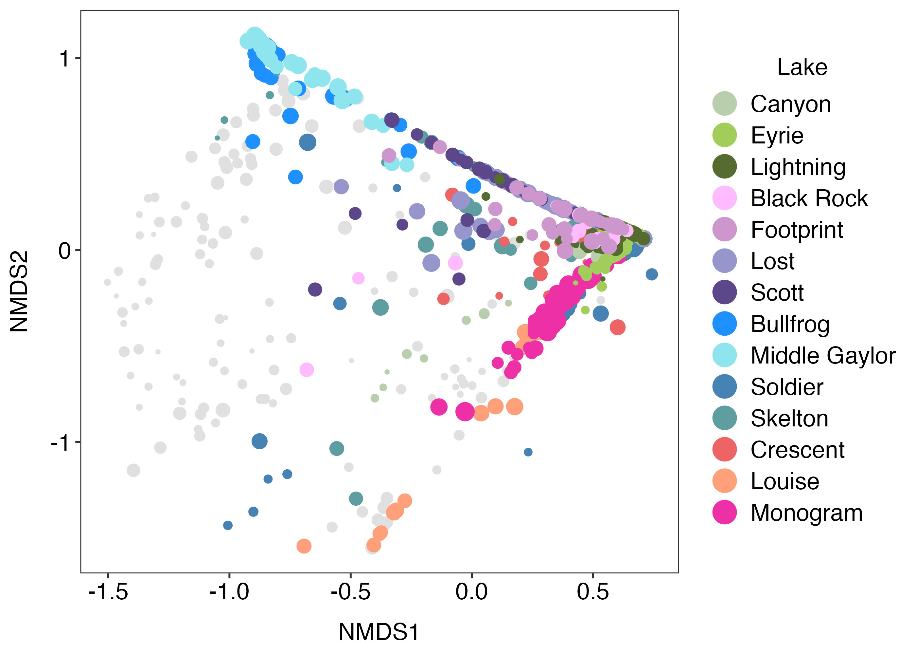
V7 Zooplankton – genus - sample

Slide 14
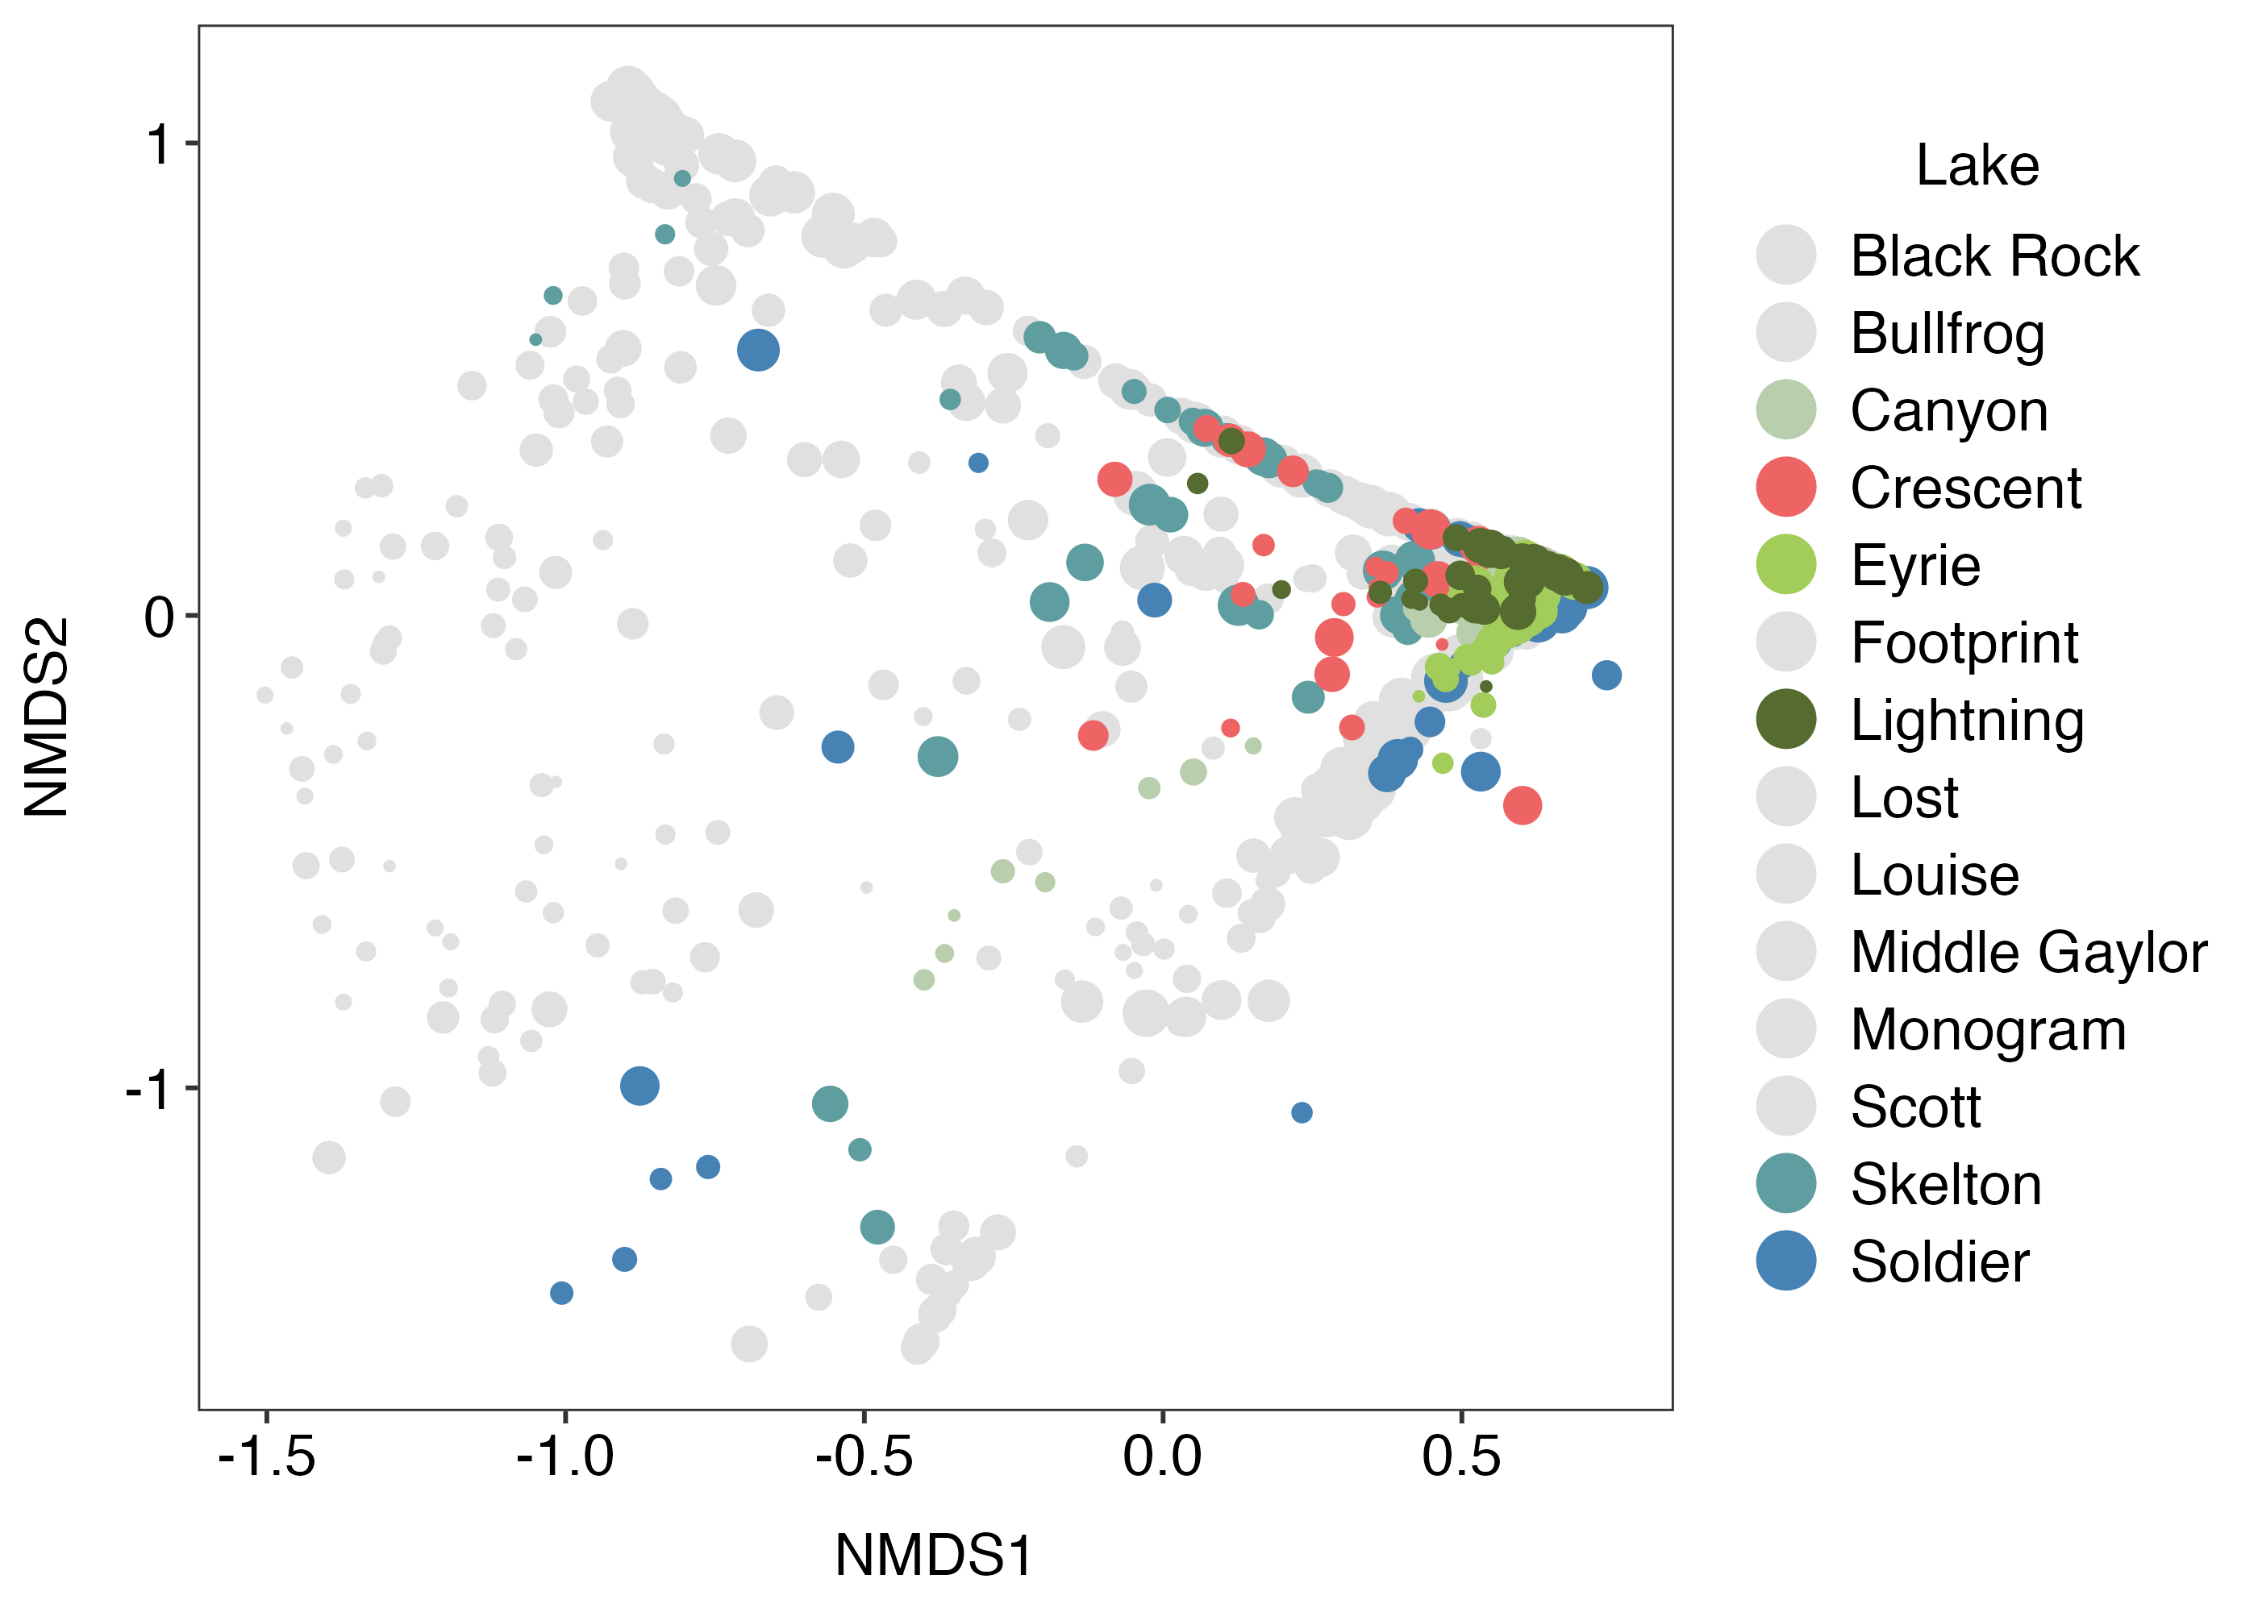
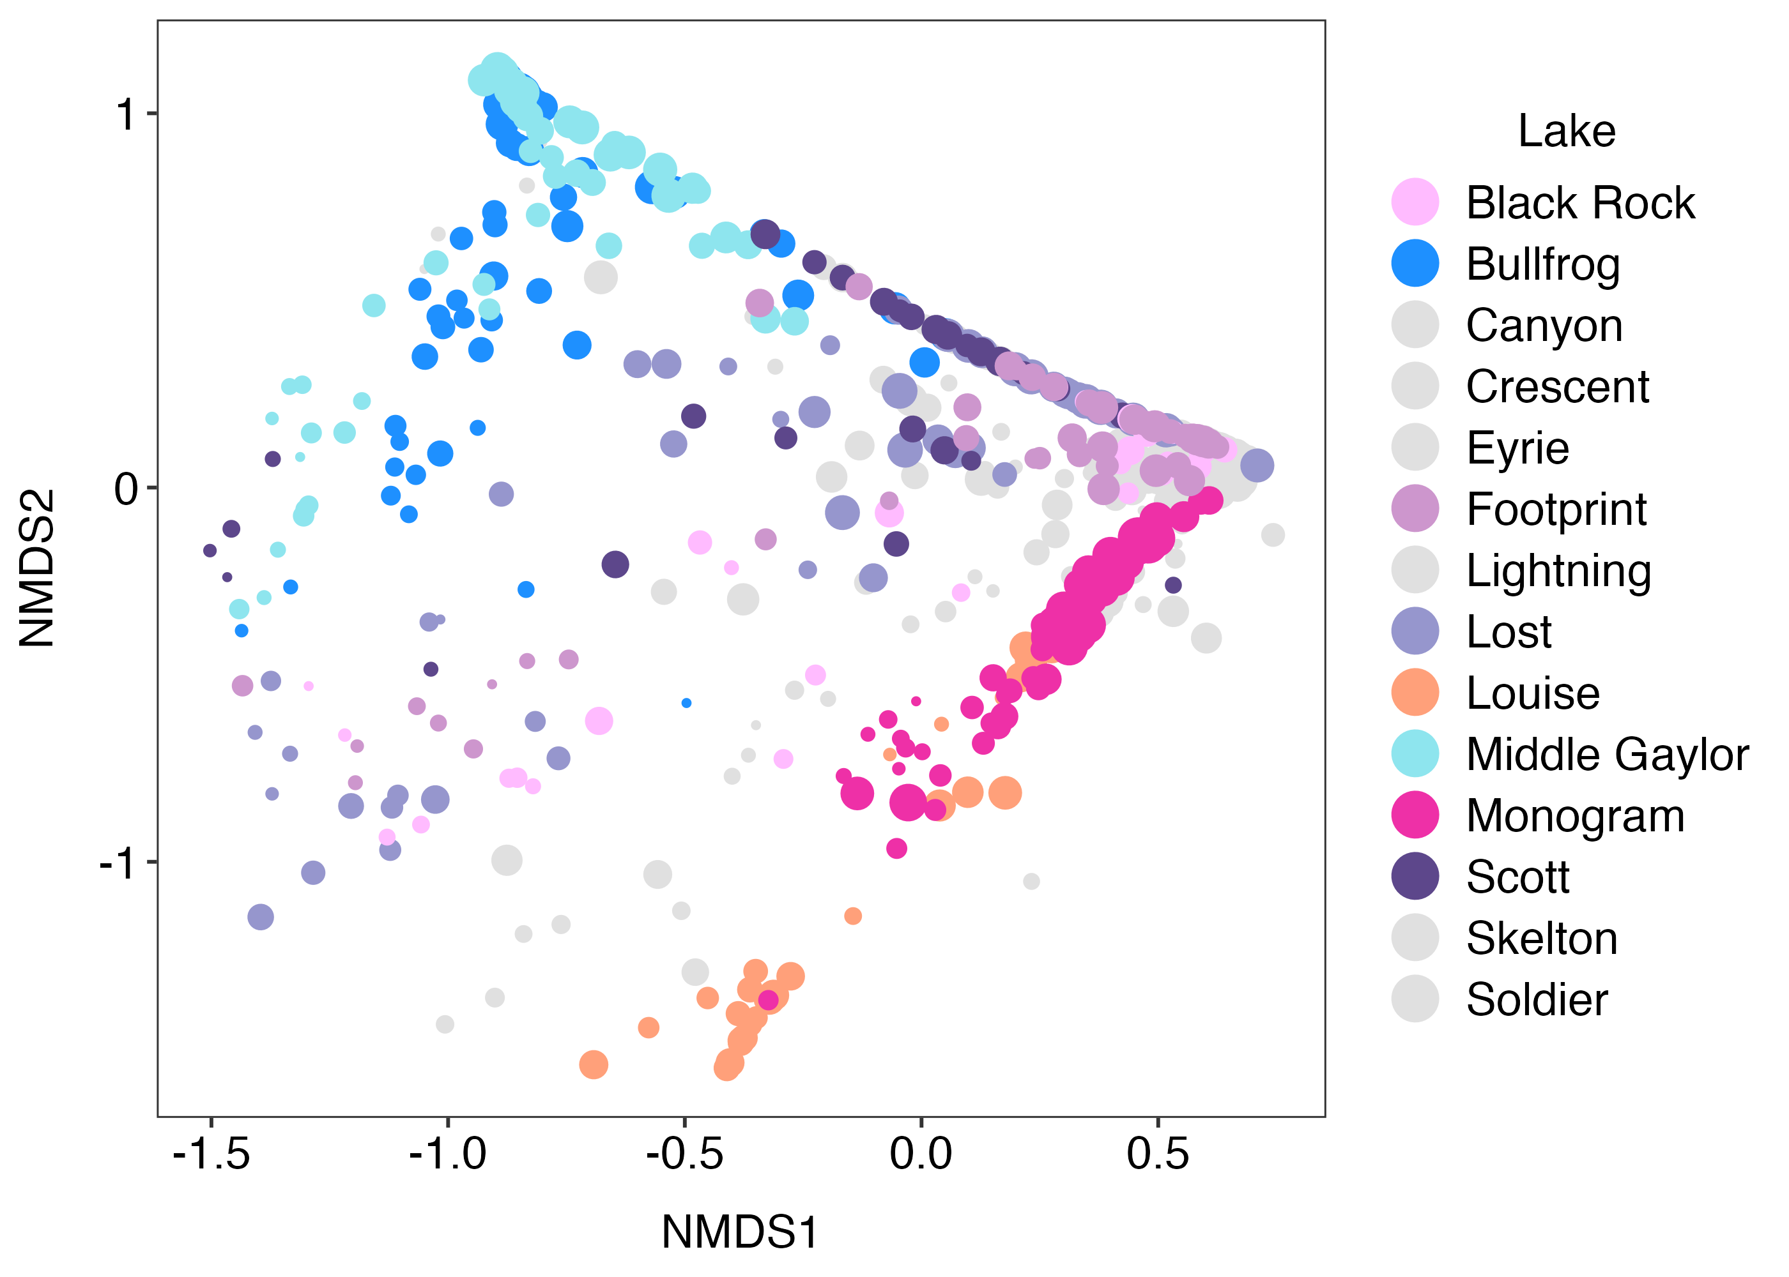
V7 Zooplankton – genus – lake

Slide 15
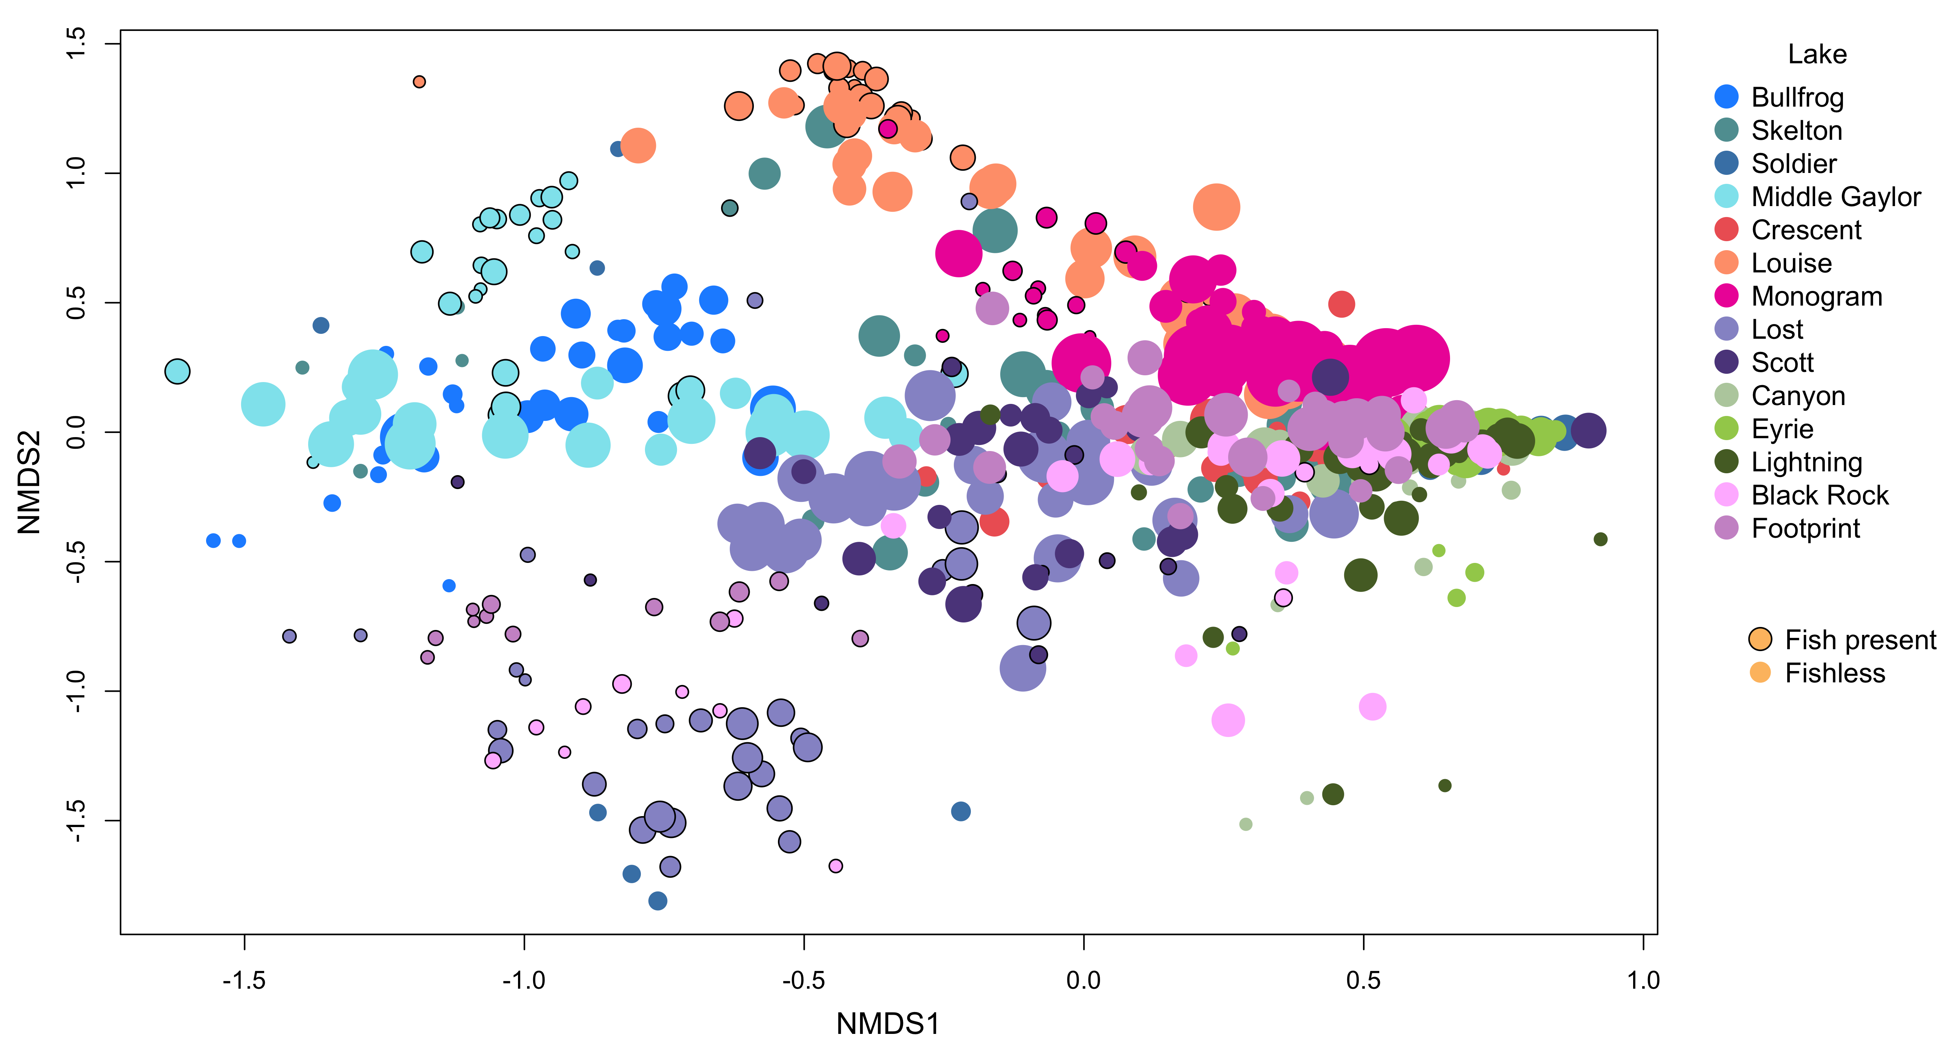
V9 Zooplankton – genus – all

Slide 16
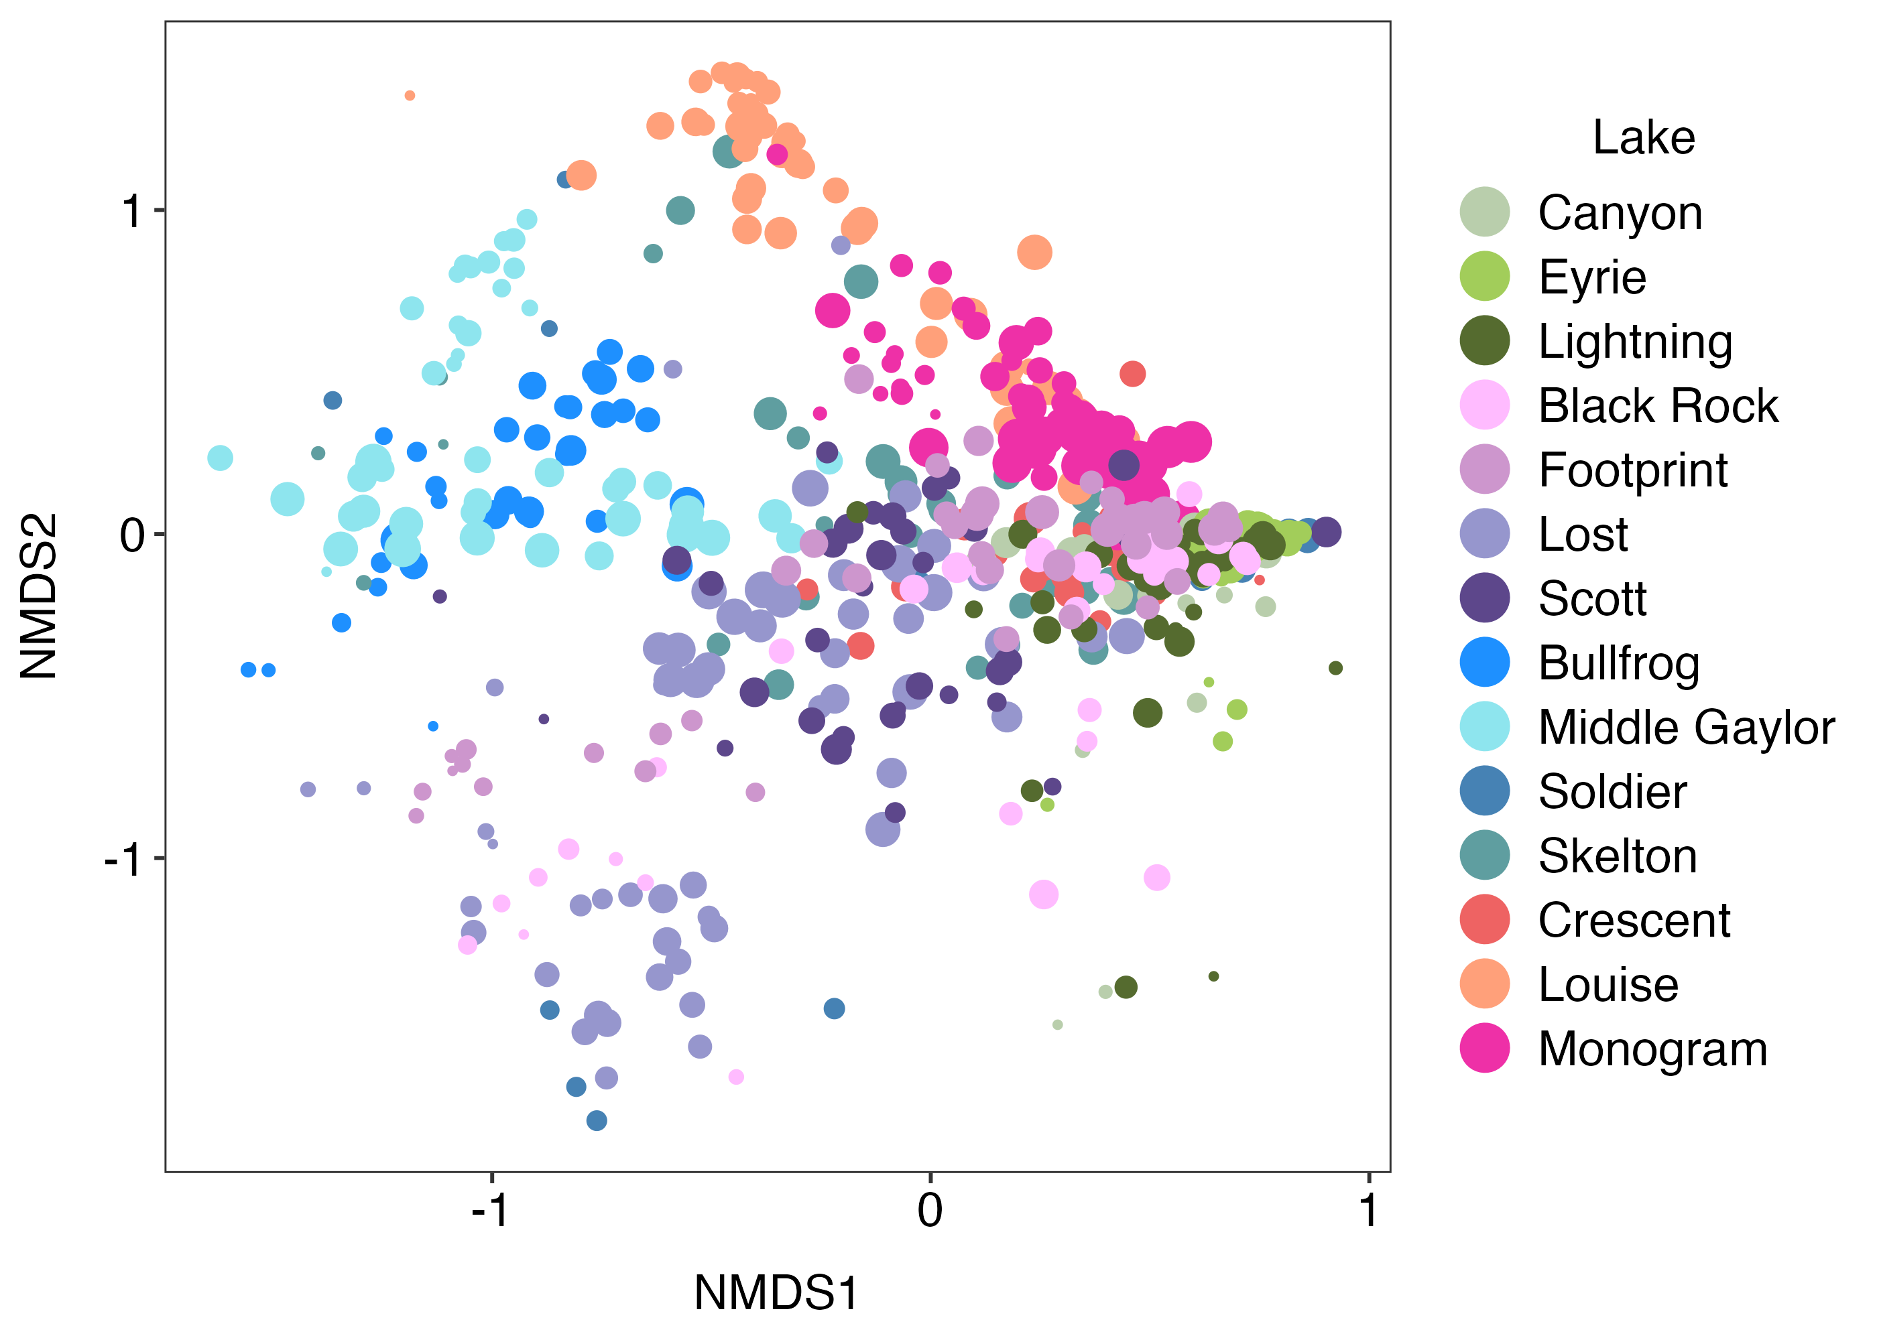
V9 Zooplankton – genus – all

Slide 17
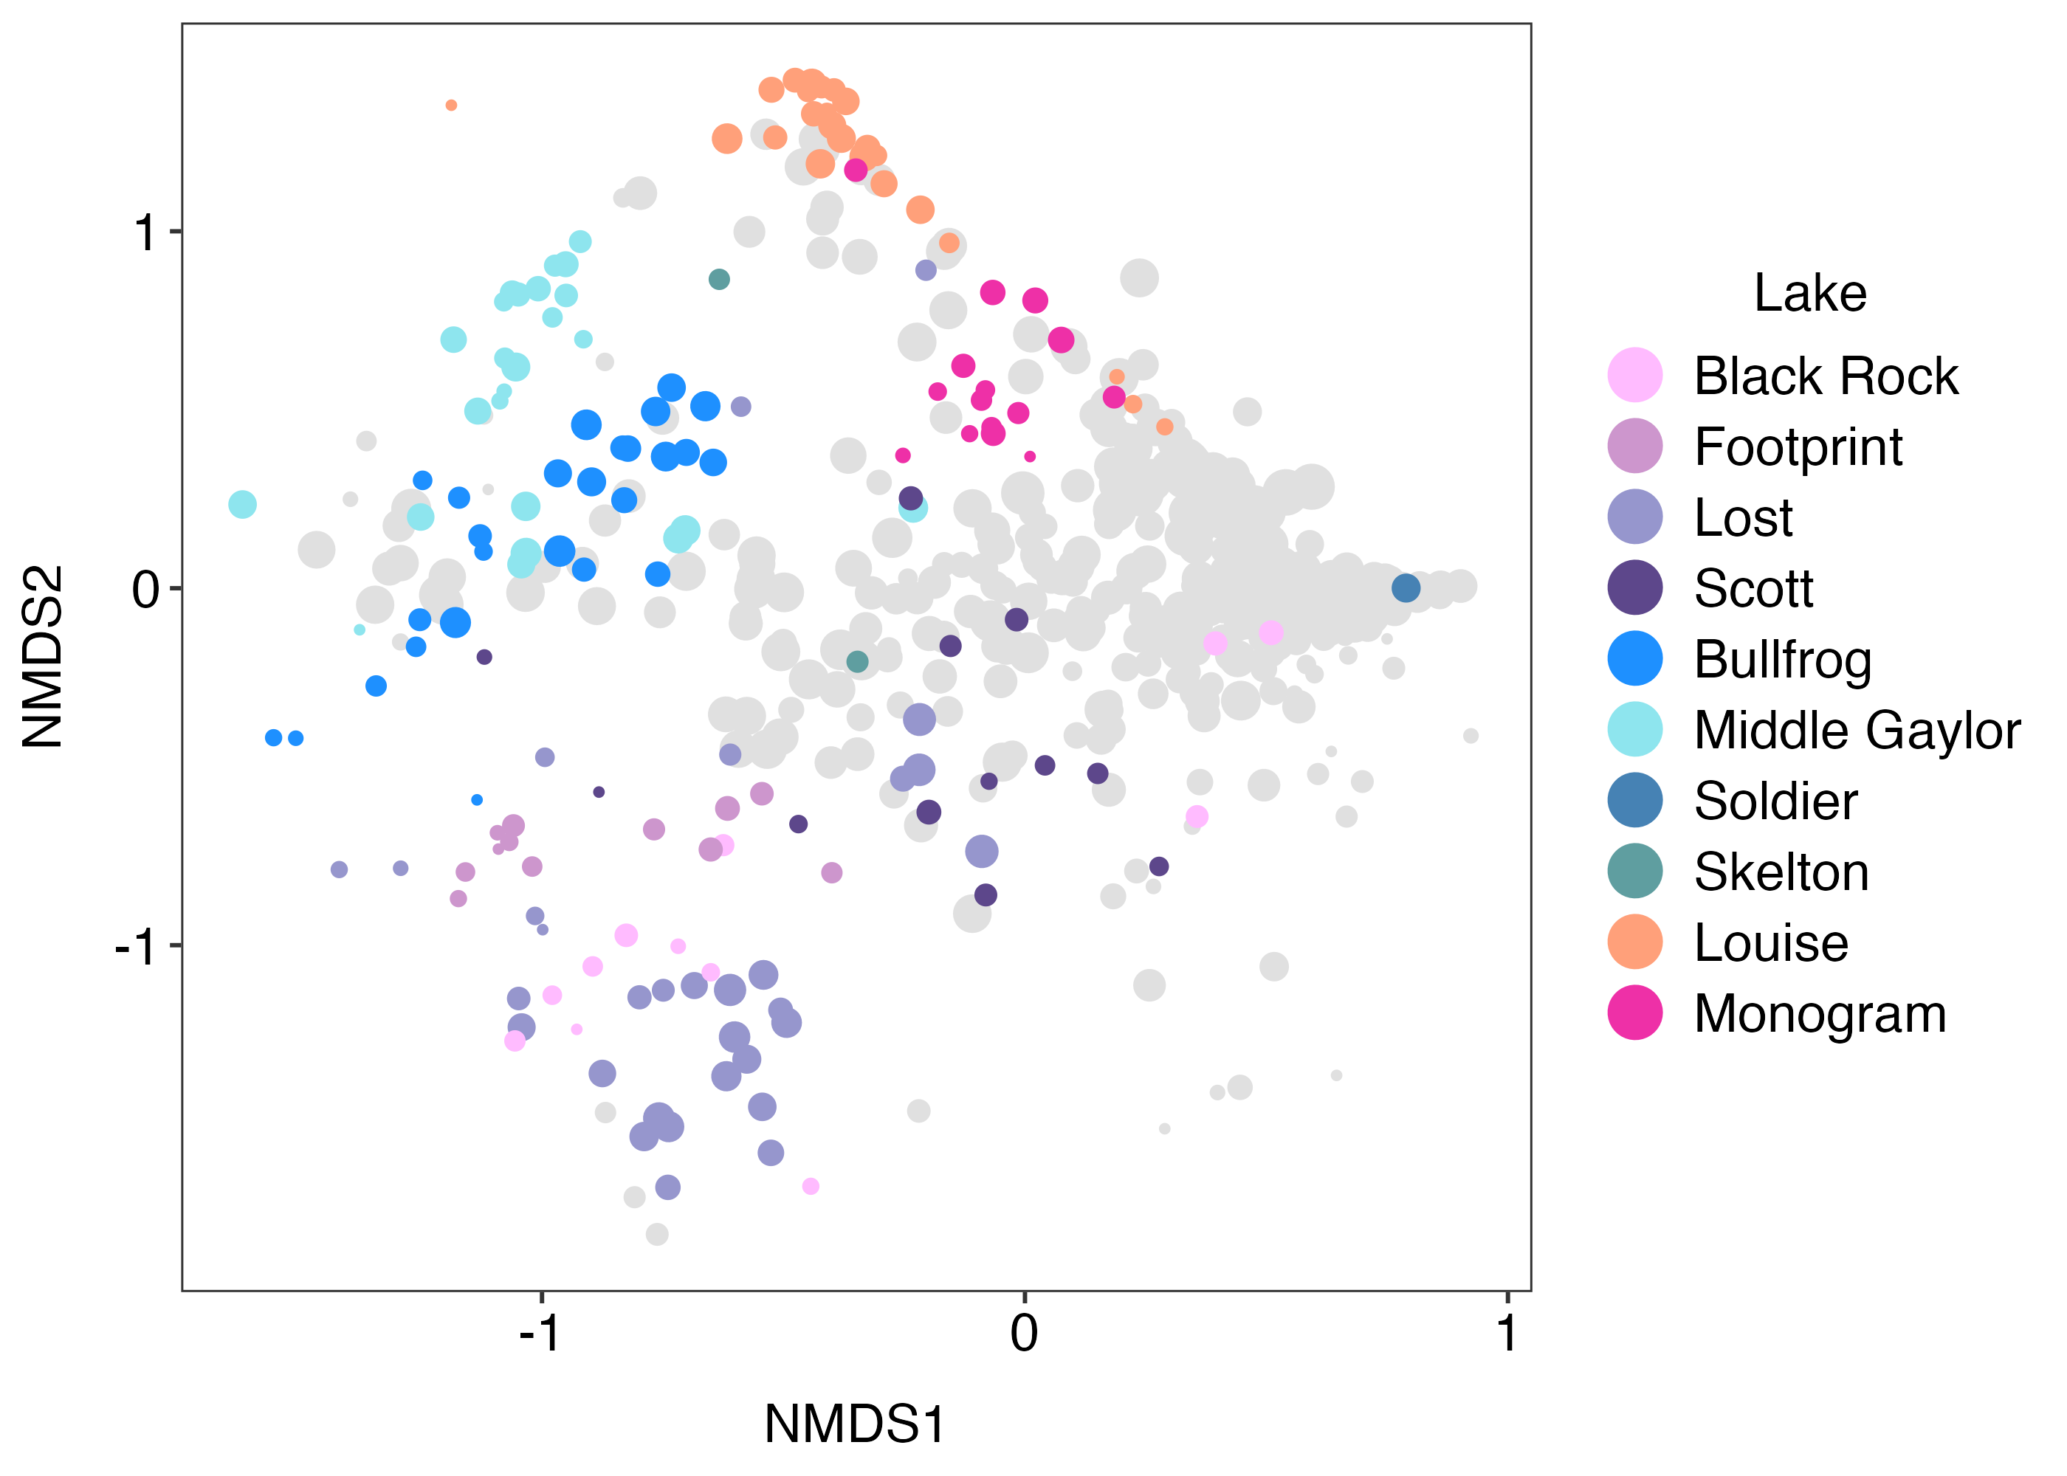
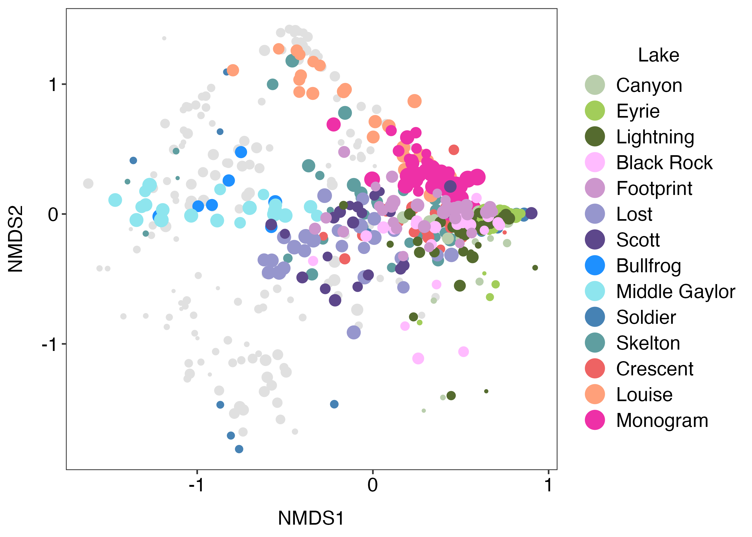
V9 Zooplankton – genus - sample

Slide 18
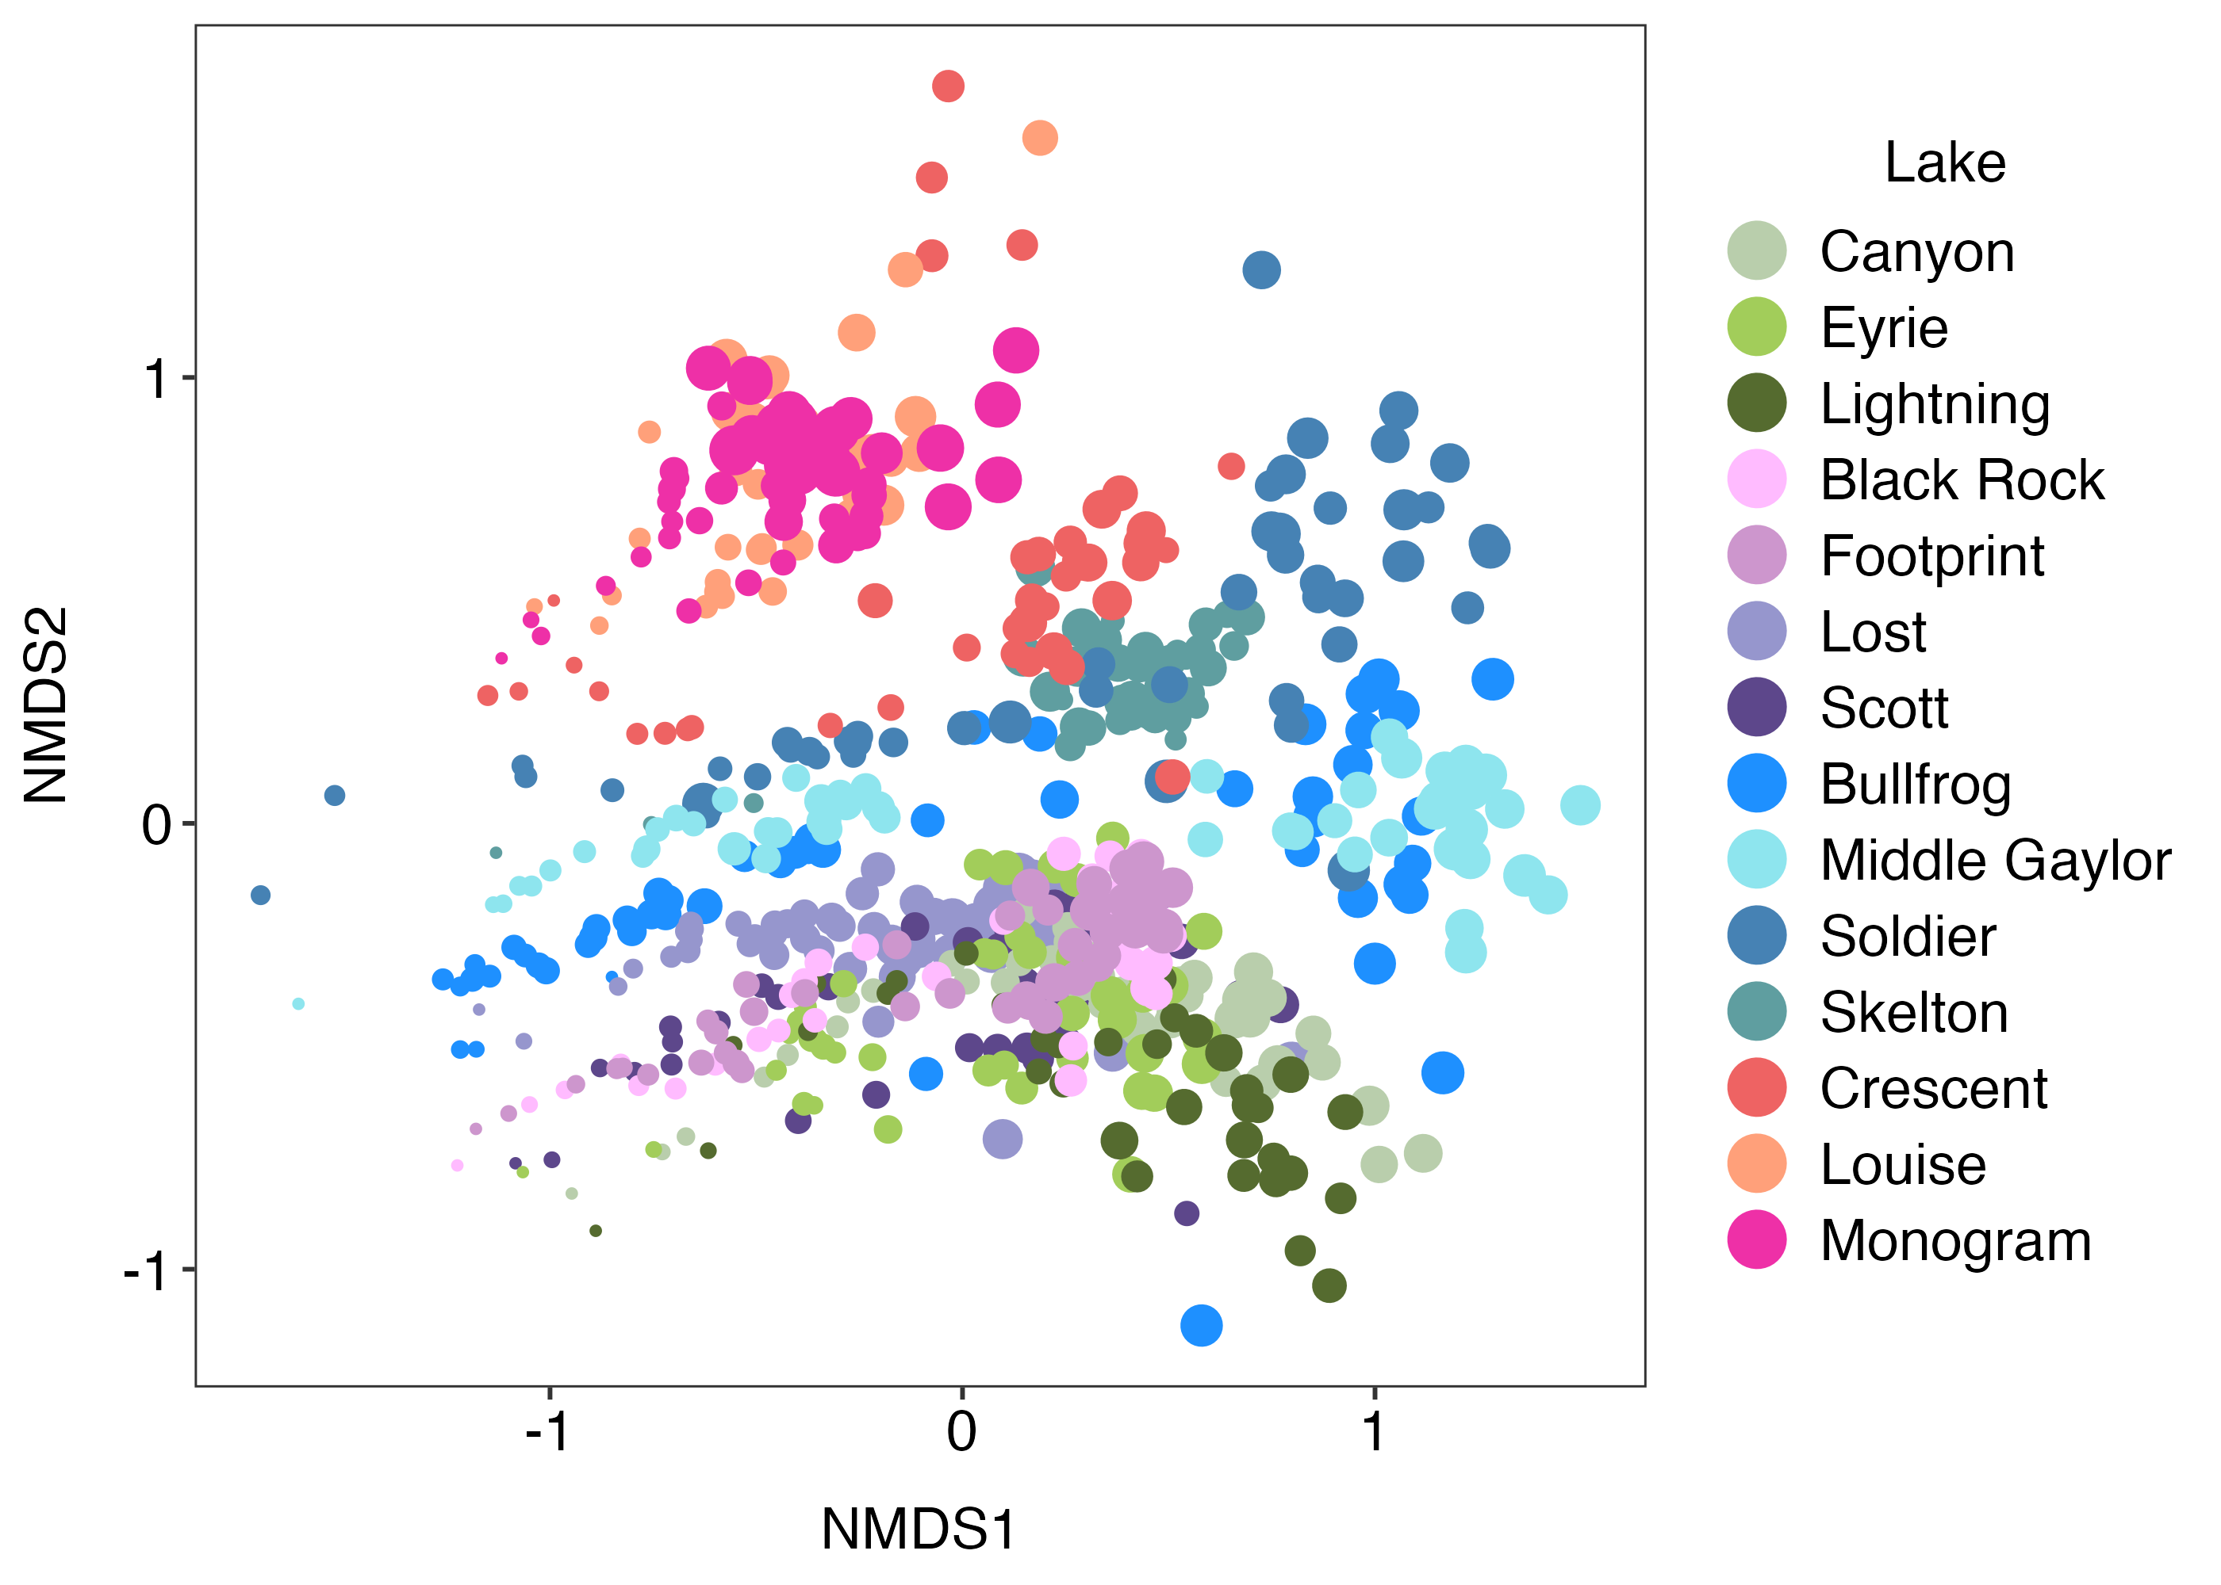
V7 Phytoplankton – ESV – all included fungi and metazoans

Slide 19
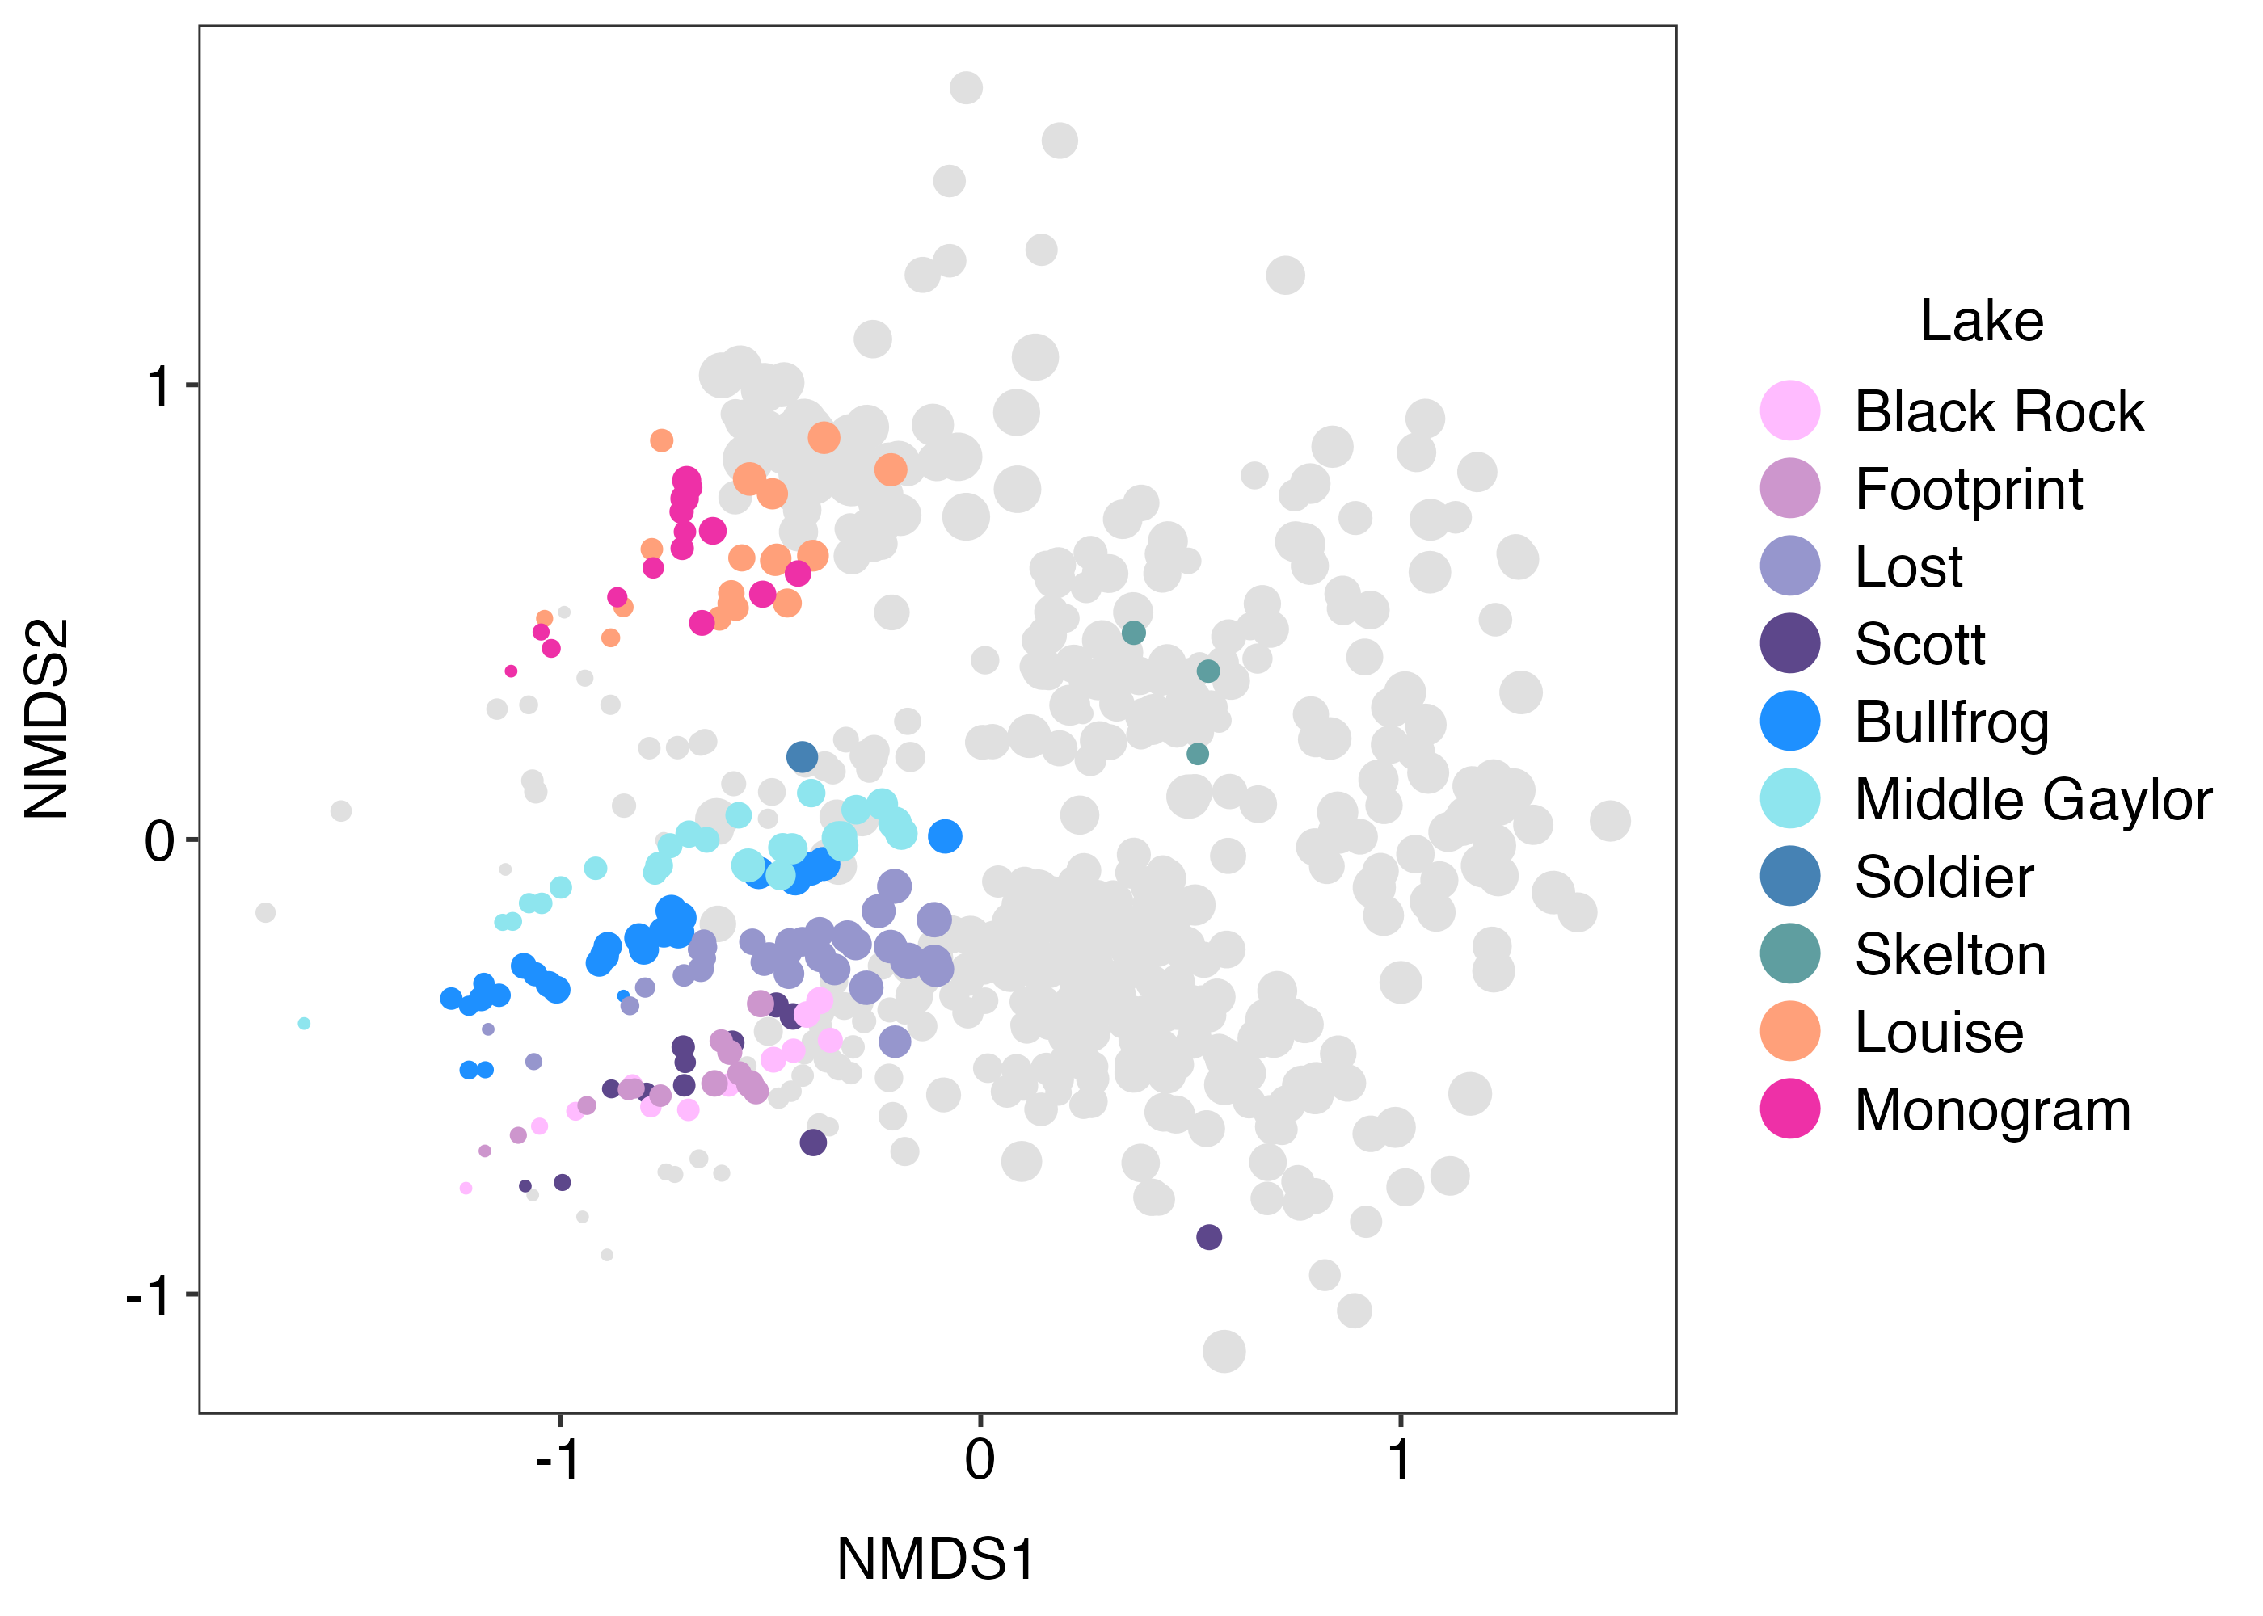
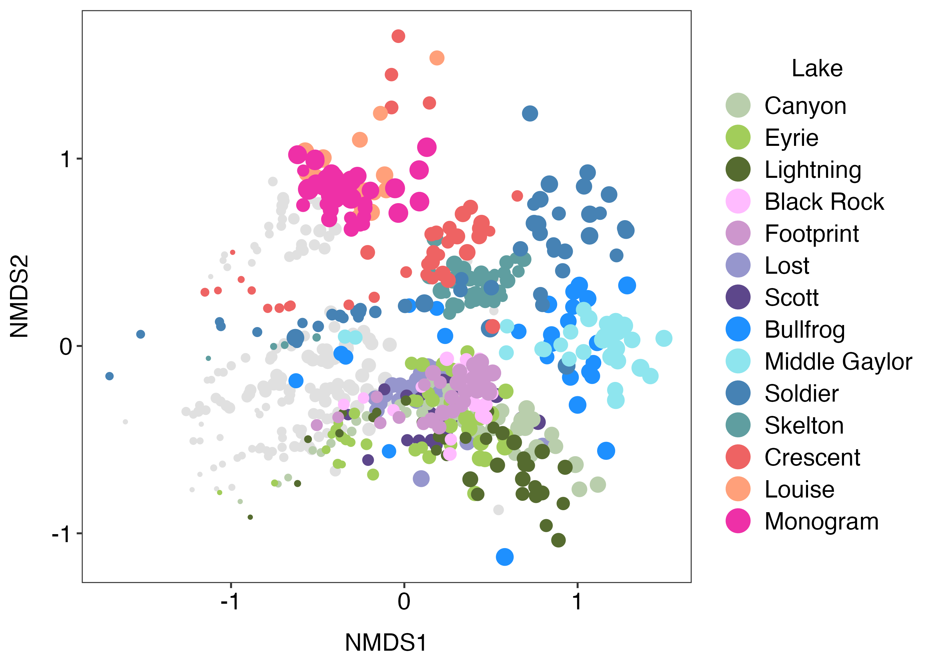
V7 Phytoplankton – genus – sample included fungi and metazoans

Slide 20
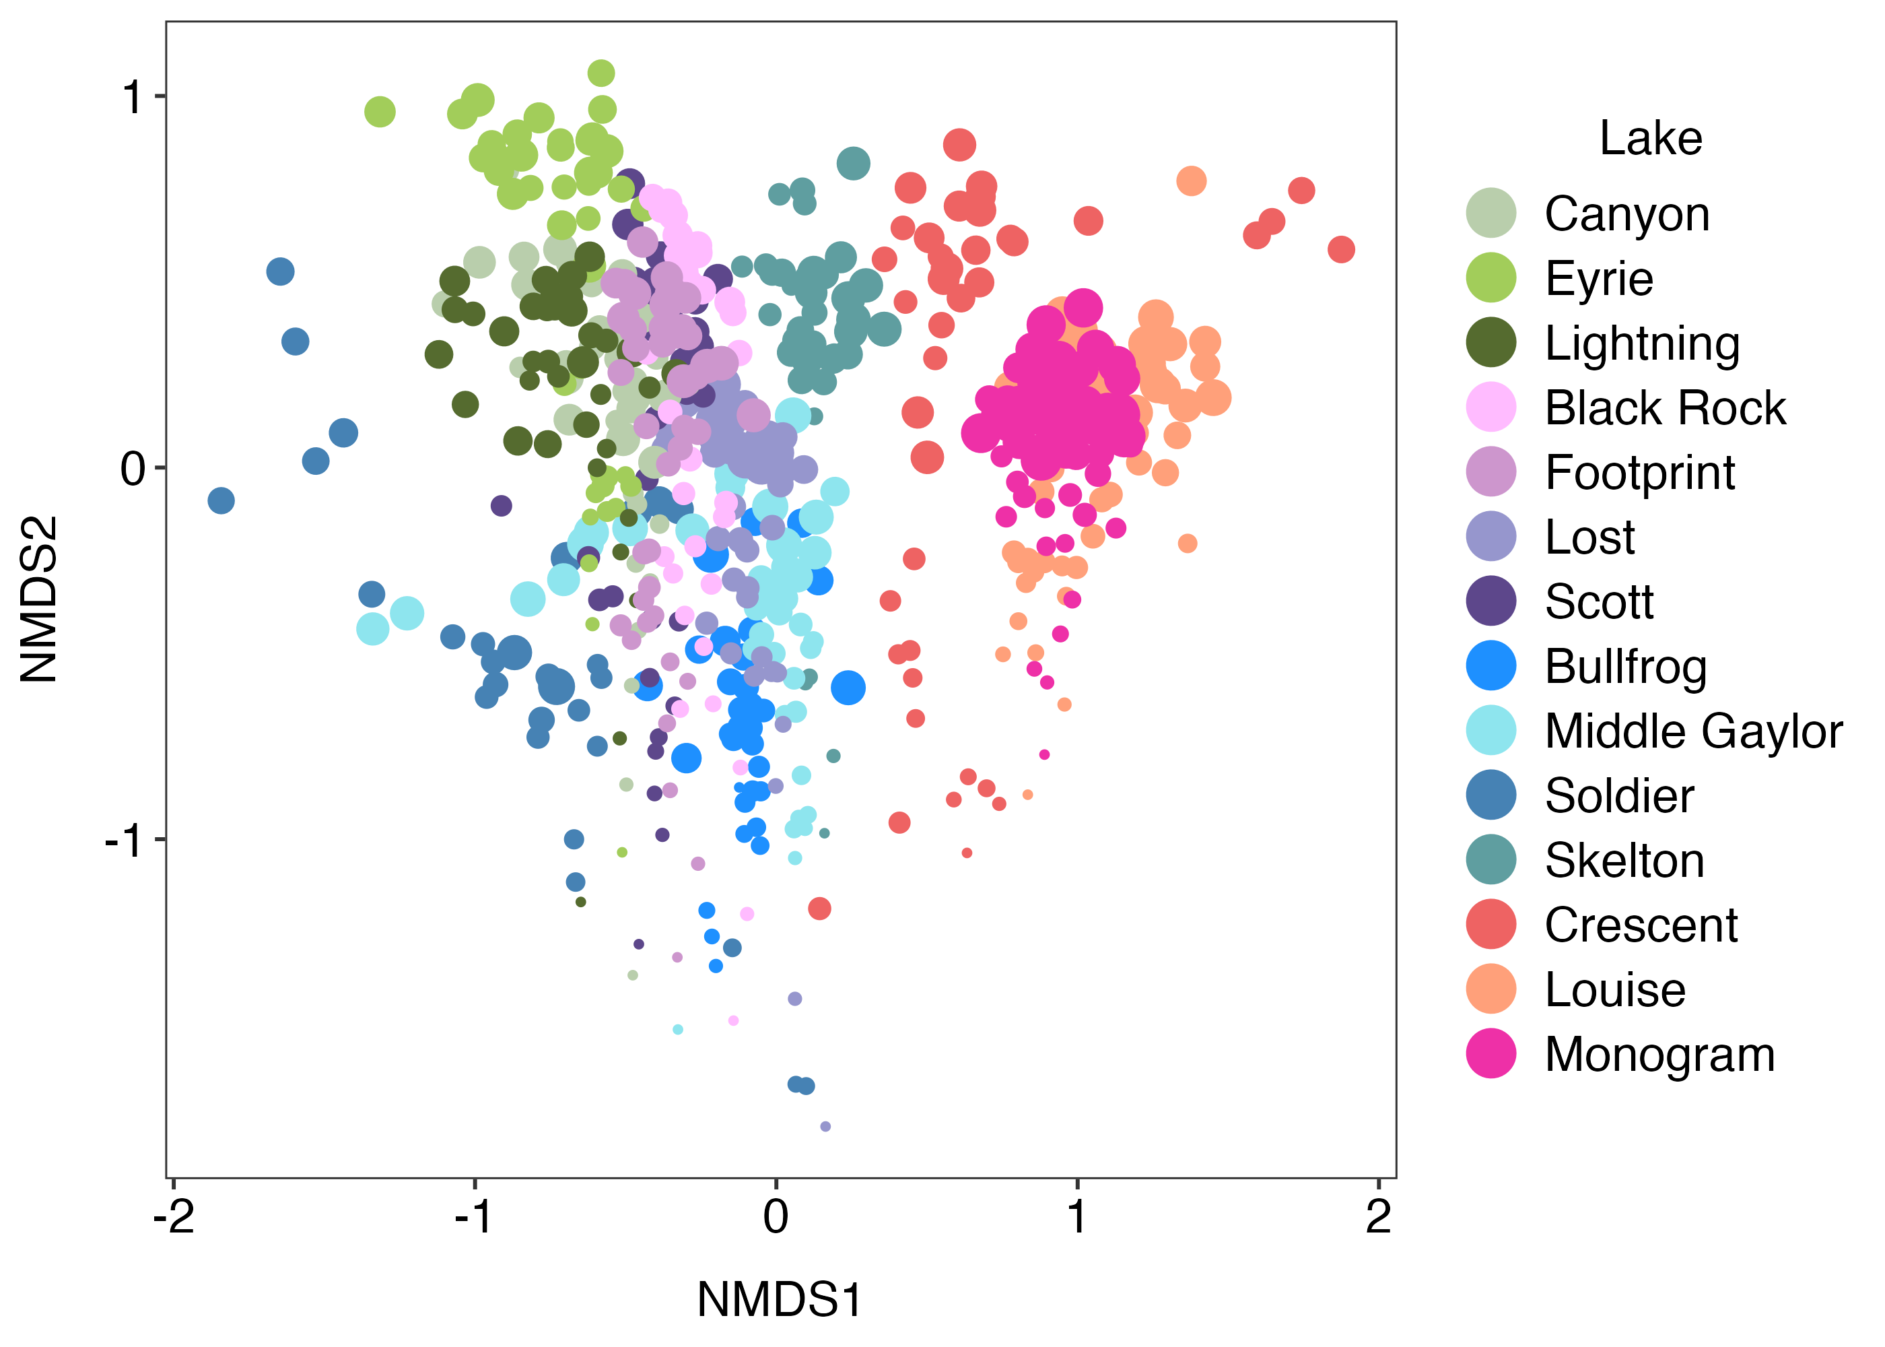
V9 Phytoplankton – ESV – all included fungi and metazoans

Slide 21
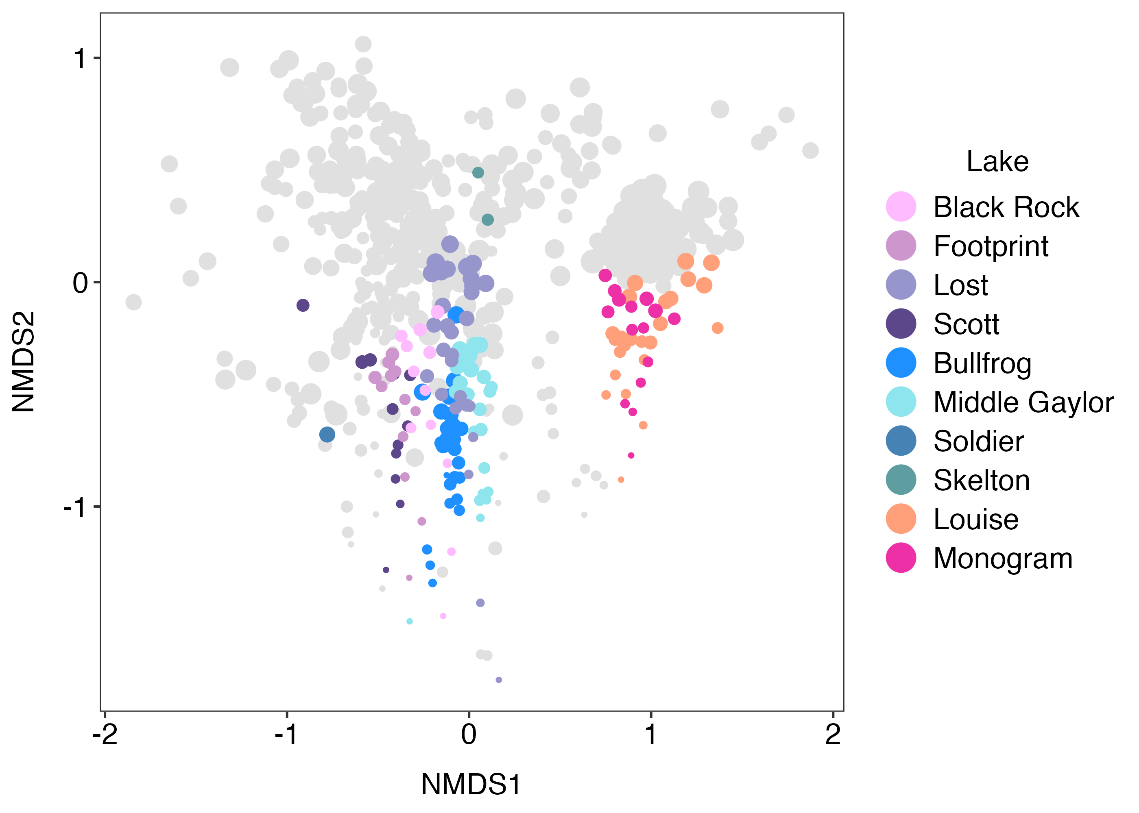
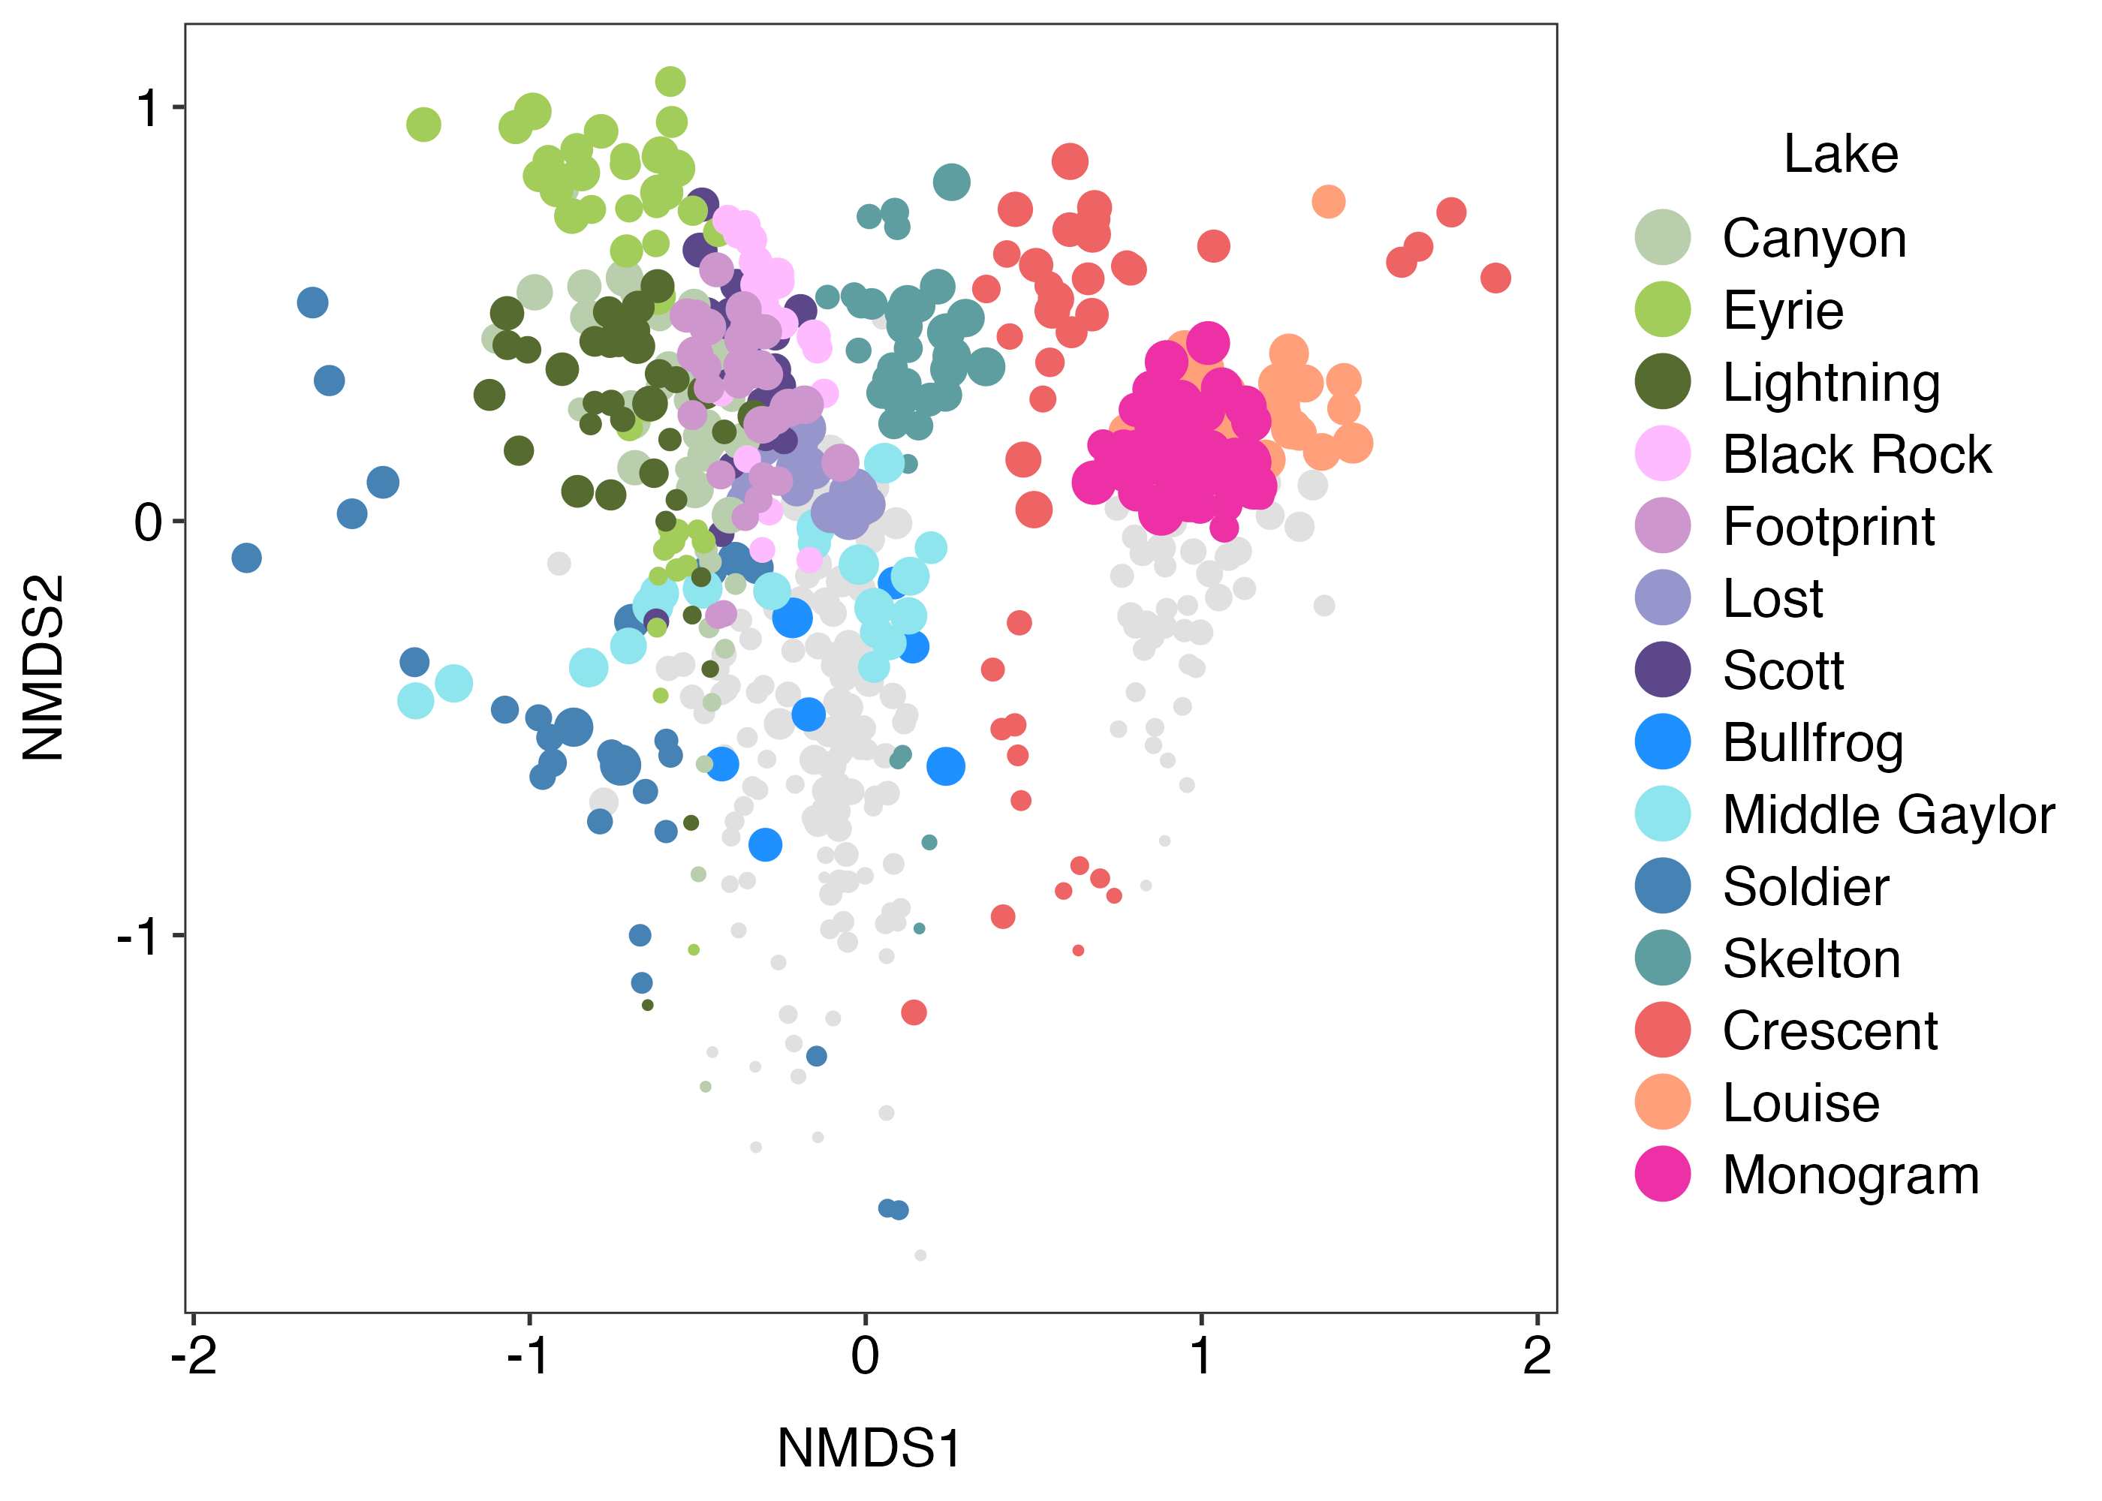
V9 Phytoplankton – genus – sample included fungi and metazoans

Slide 22
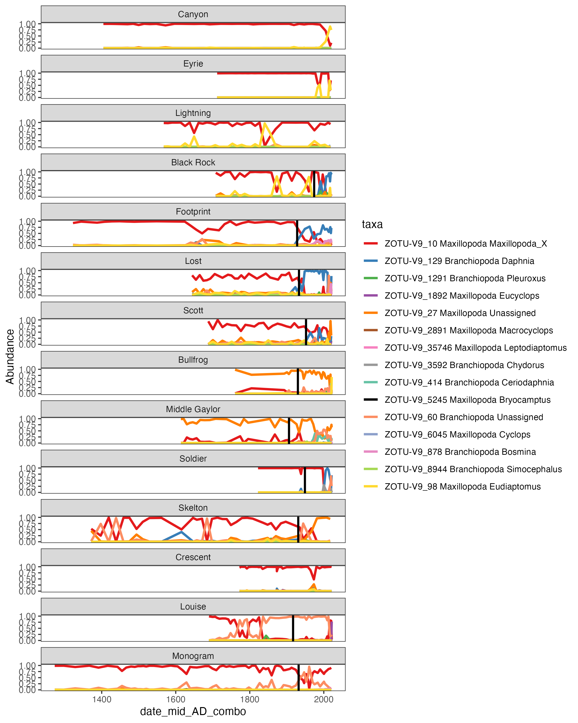
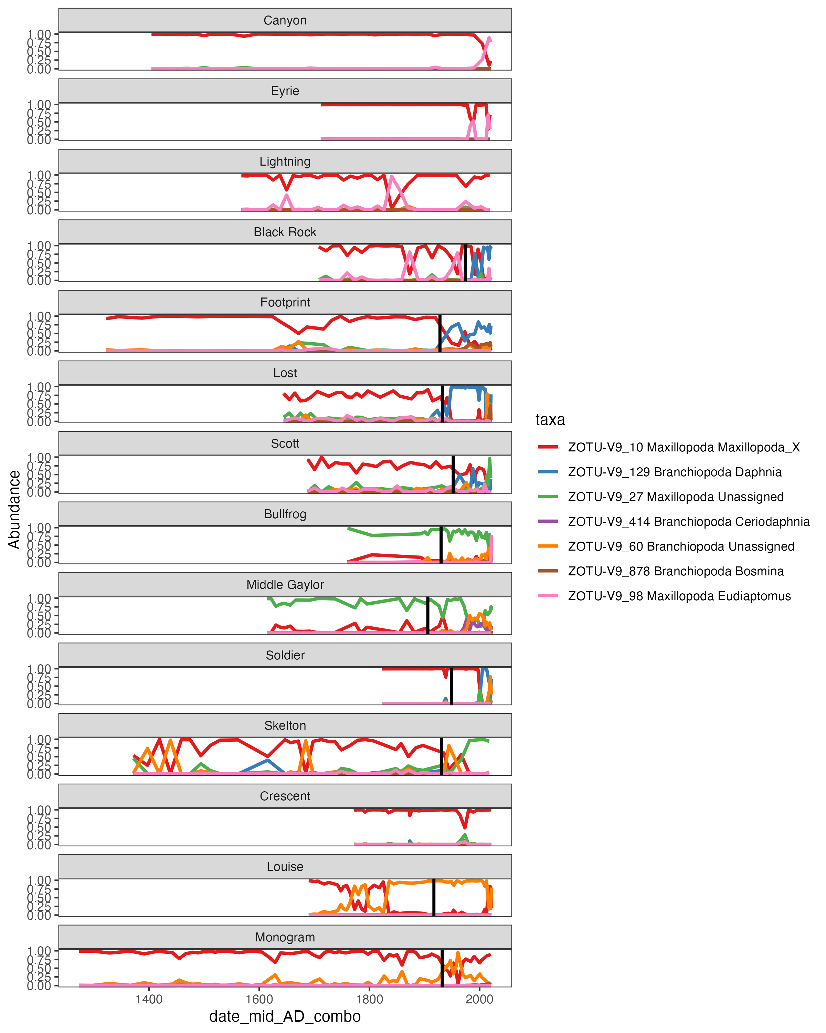
V9 Zooplankton – genus

Slide 23
New slides below

Slide 24
Fish
Fishless
Present
Past
Present
Past
Present
Past
Fish
Fishless
Present
Past
Present
Past
Present
Past
Notes:
Do we want the fish lakes jumbled? or should they all start looking the same in the past? I will switch to past/present (left to right) in final version

Slide 25
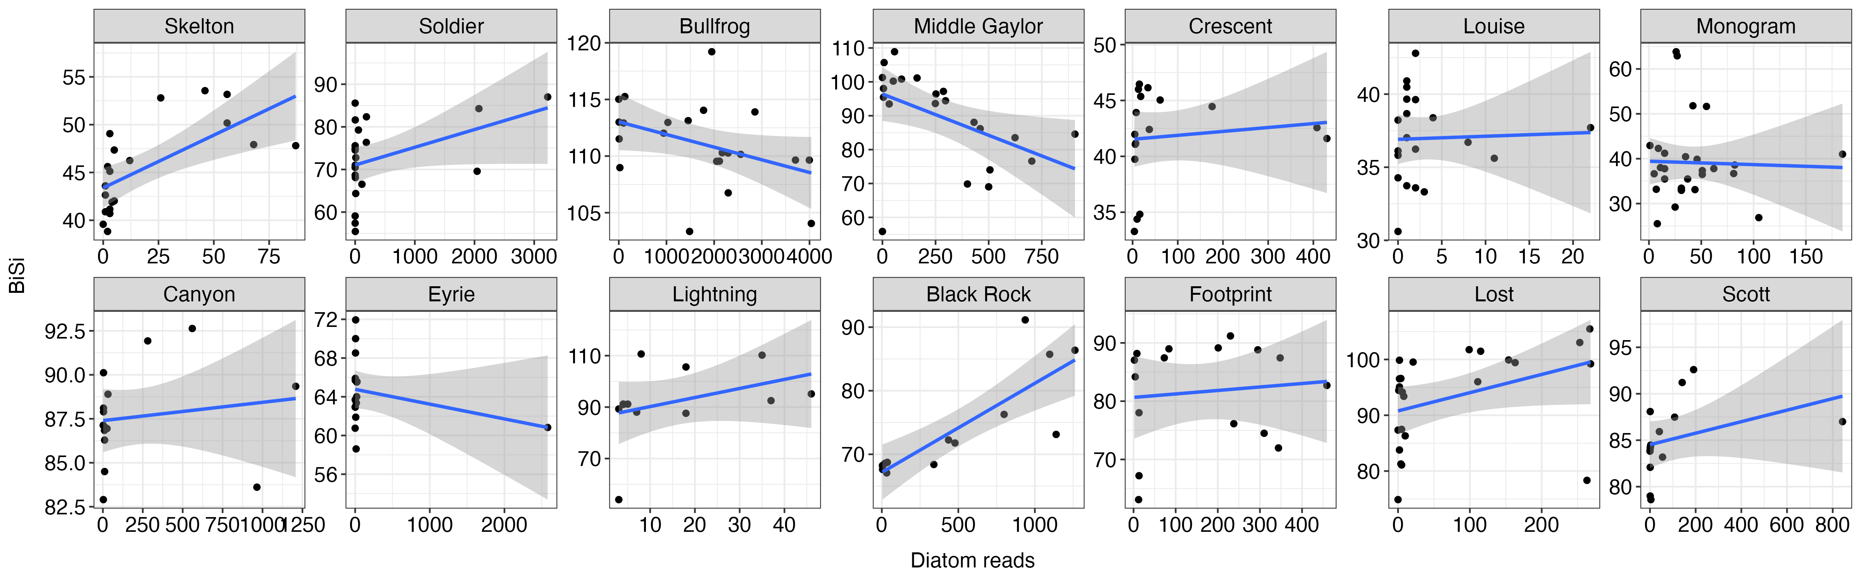
Biogenic silica and diatom abundances

Slide 26
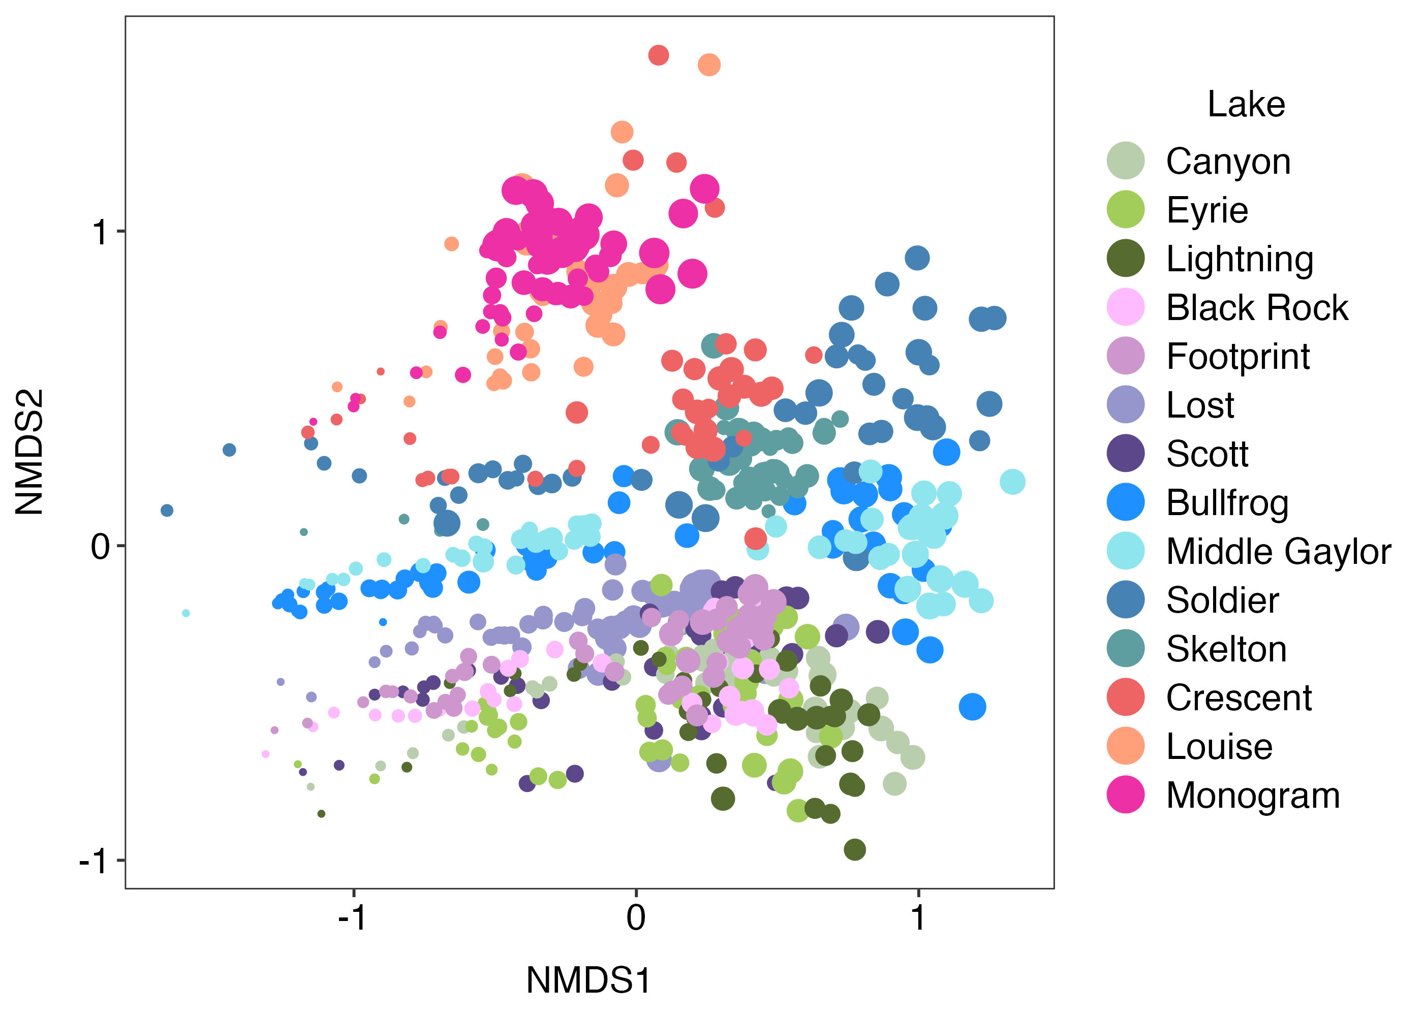
V7 Phytoplankton – ESV – all

Slide 27
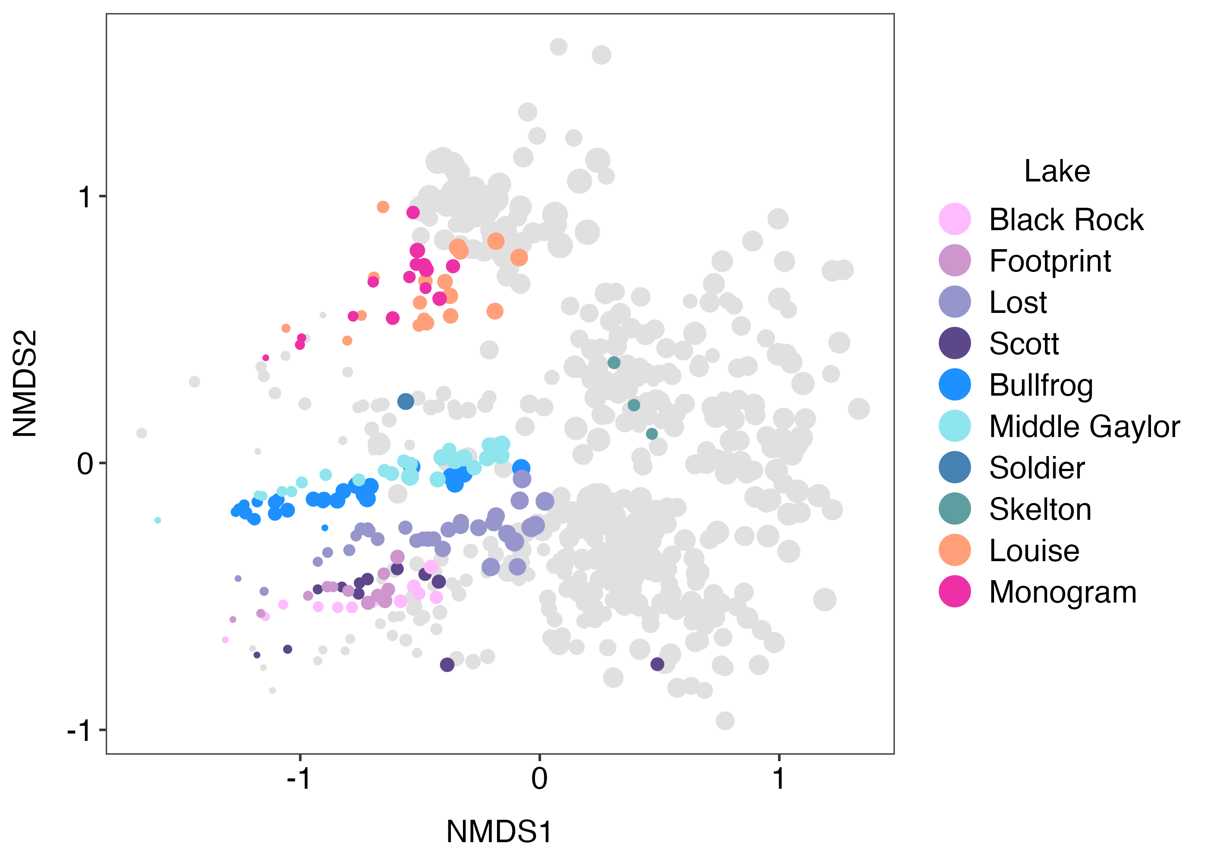
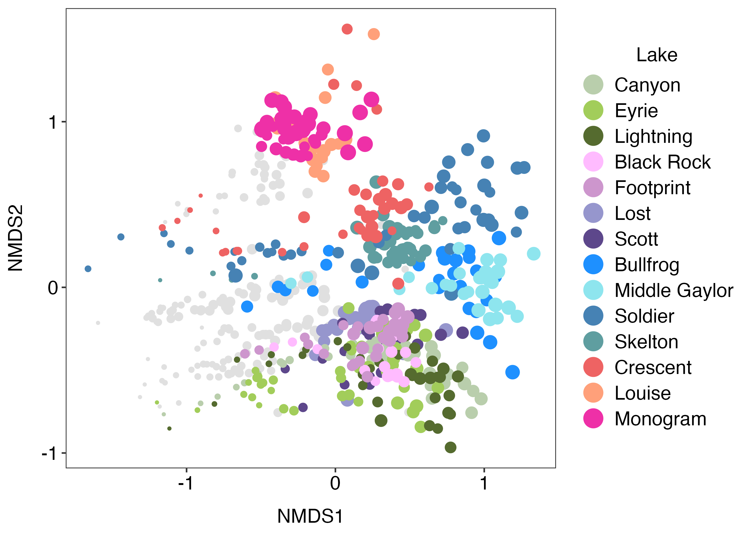
V7 Phytoplankton – genus – sample

Slide 28
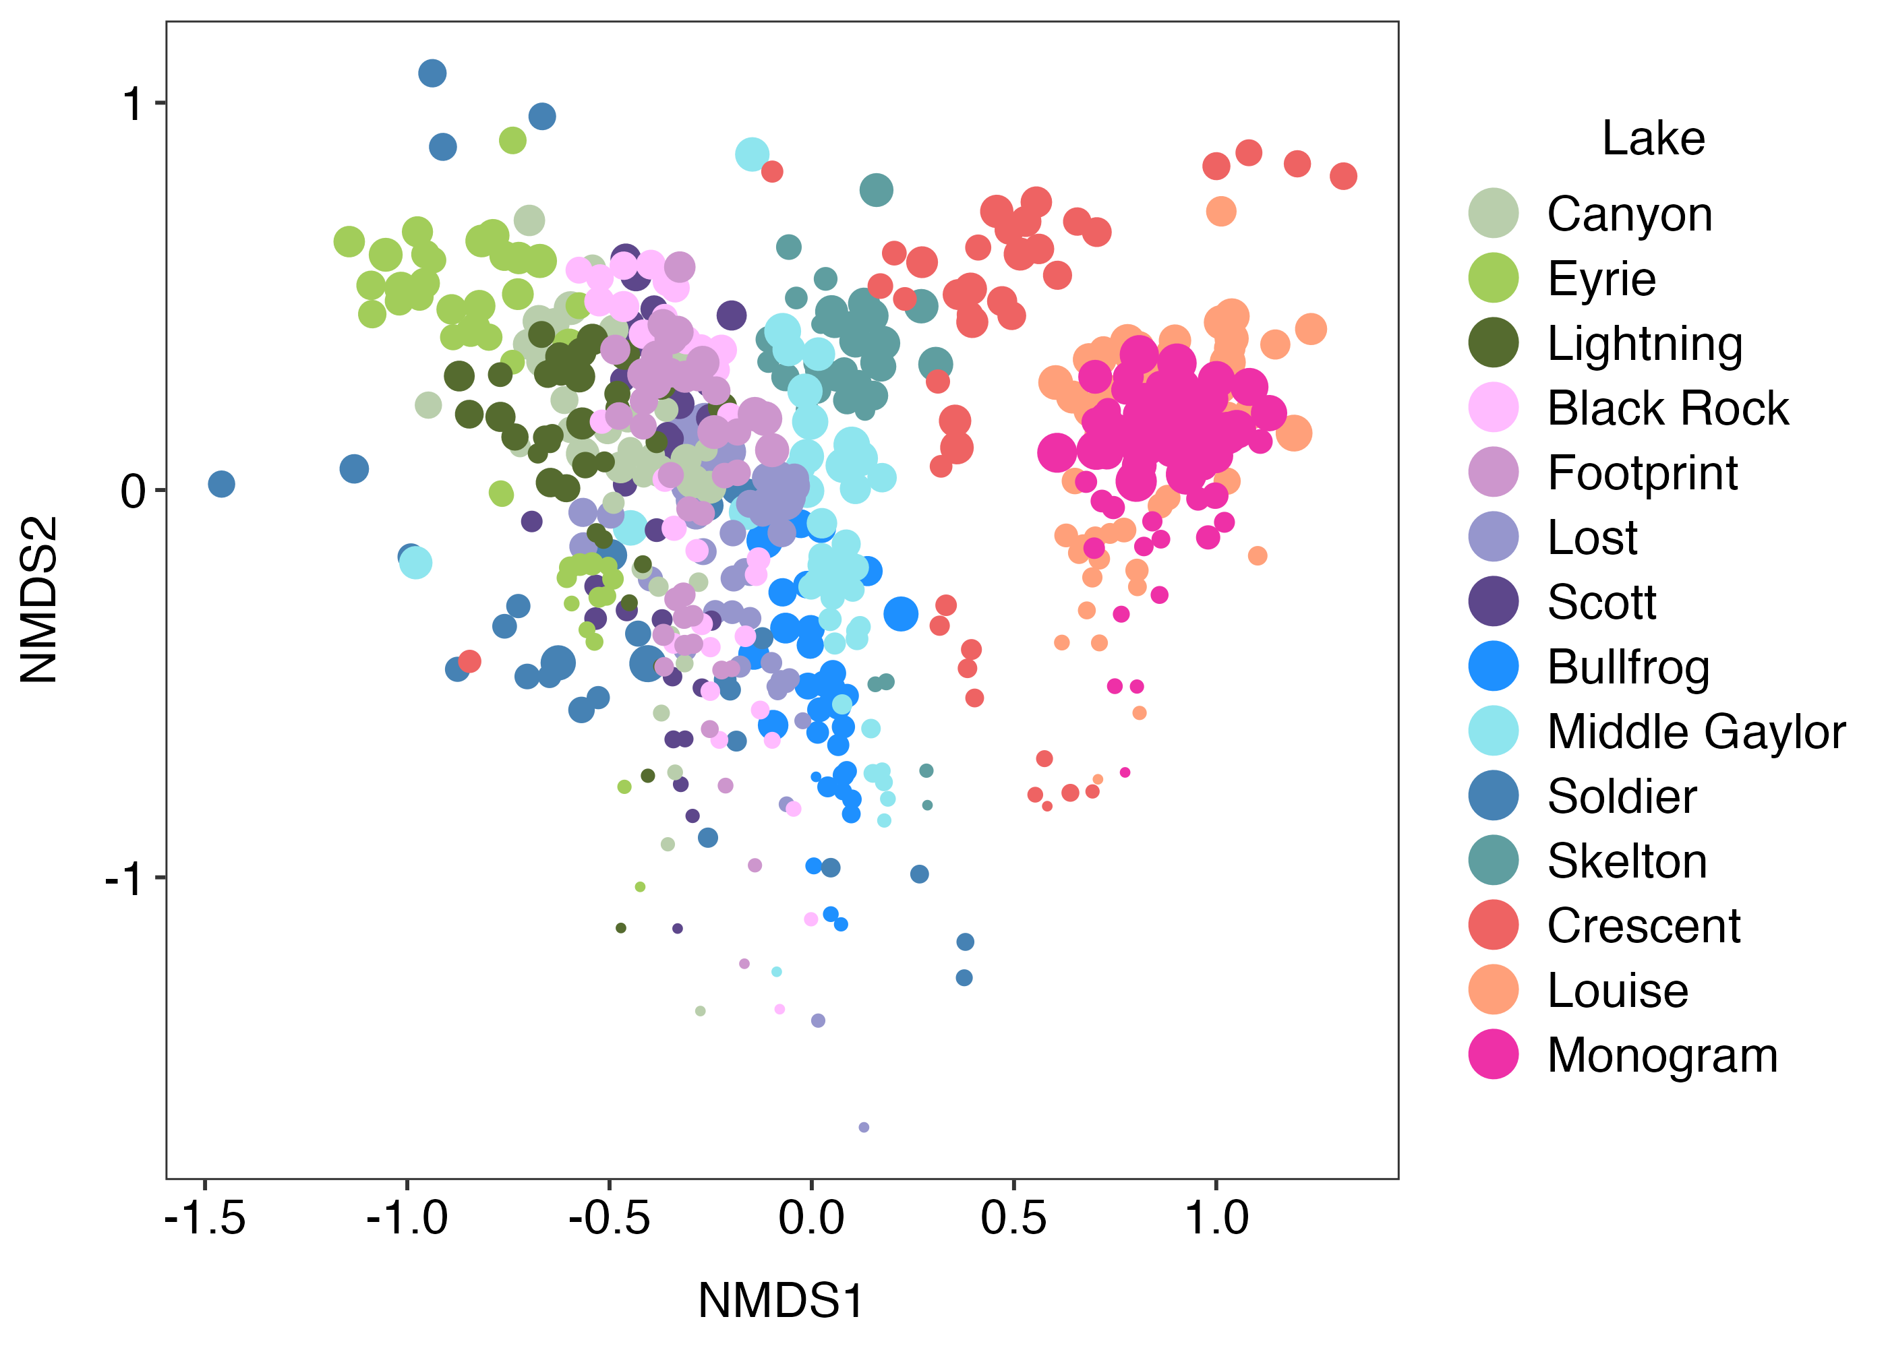
V9 Phytoplankton – ESV – all

Slide 29
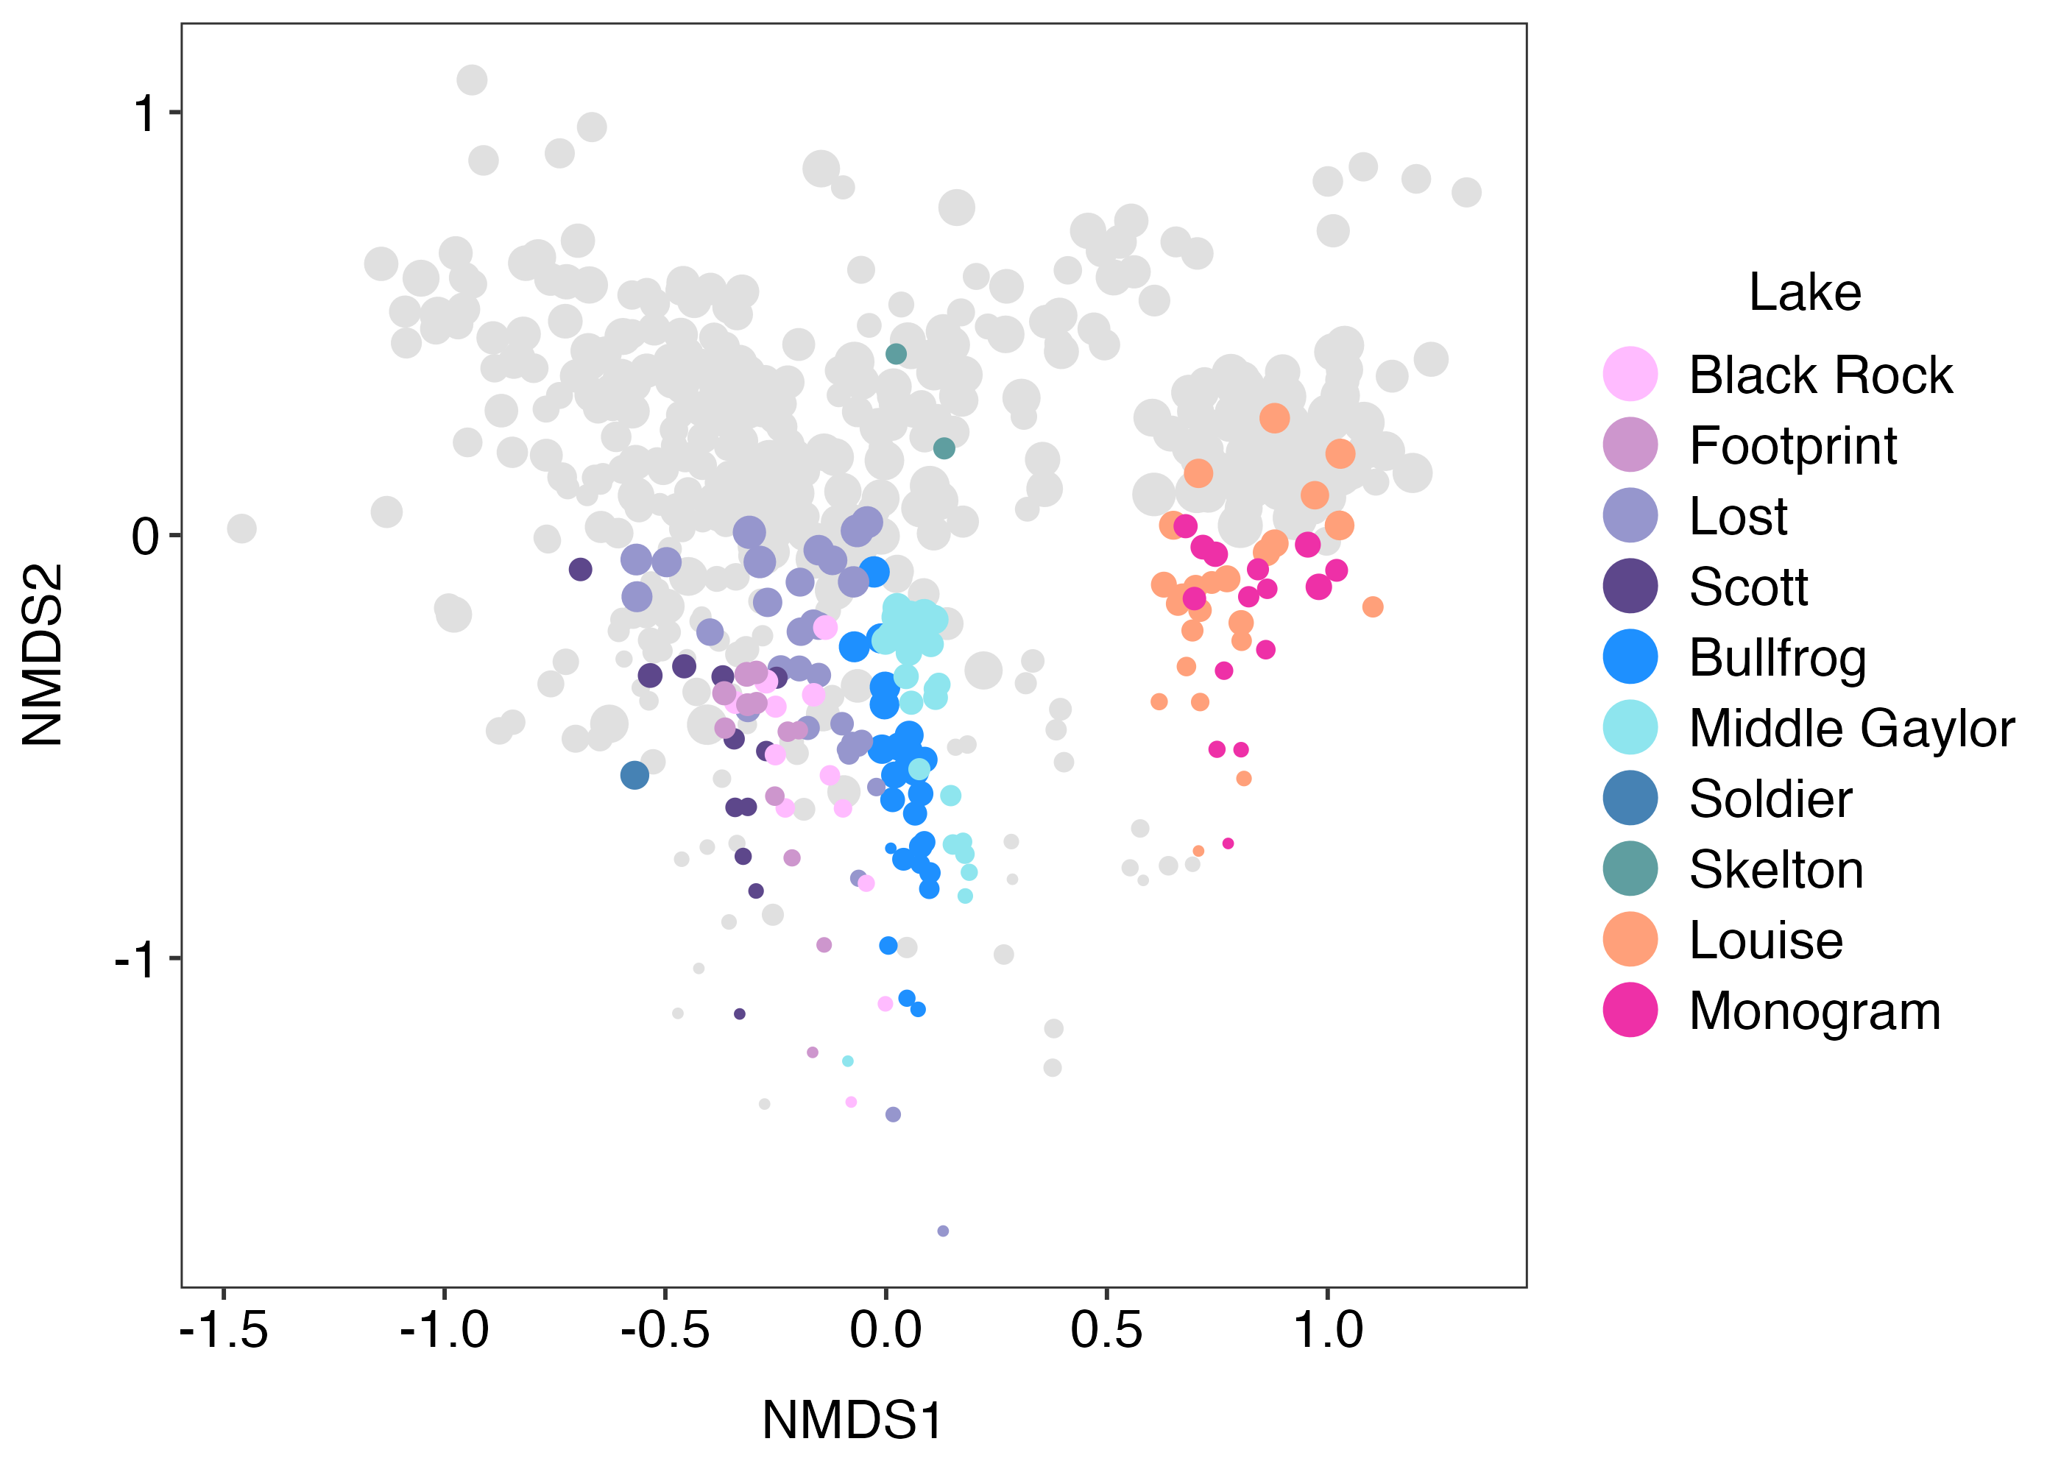
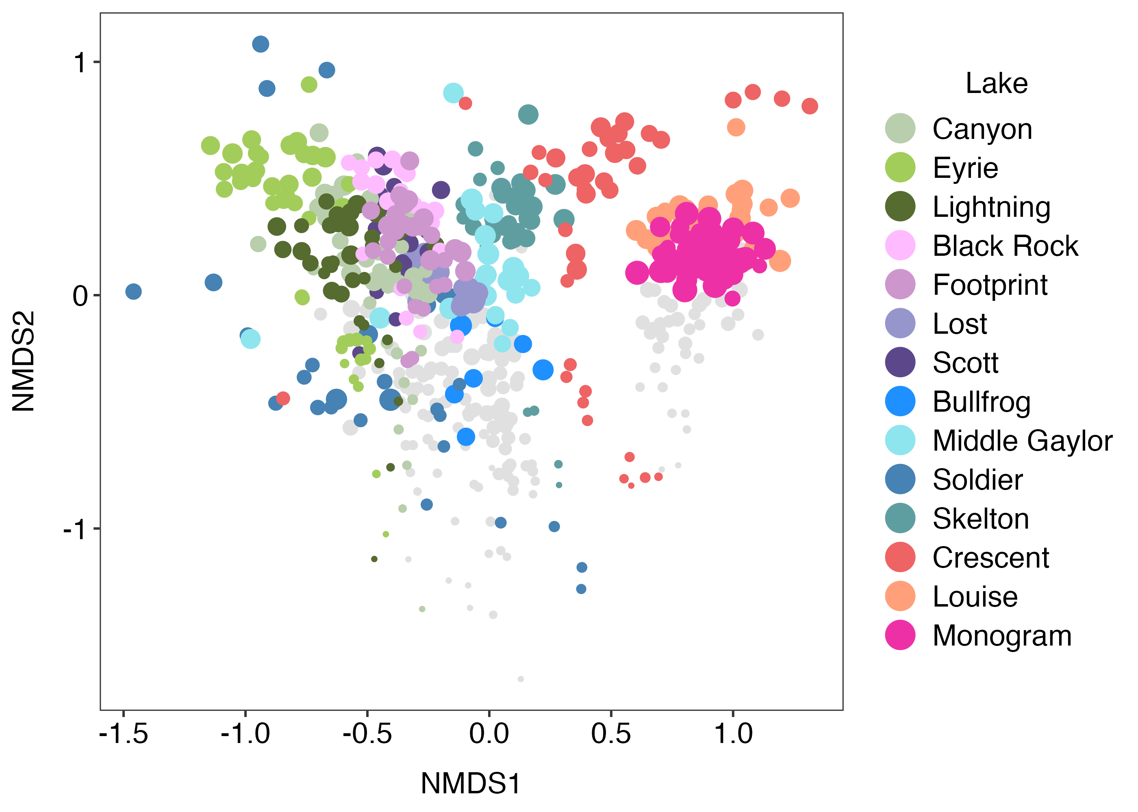
V9 Phytoplankton – genus – sample

Slide 30
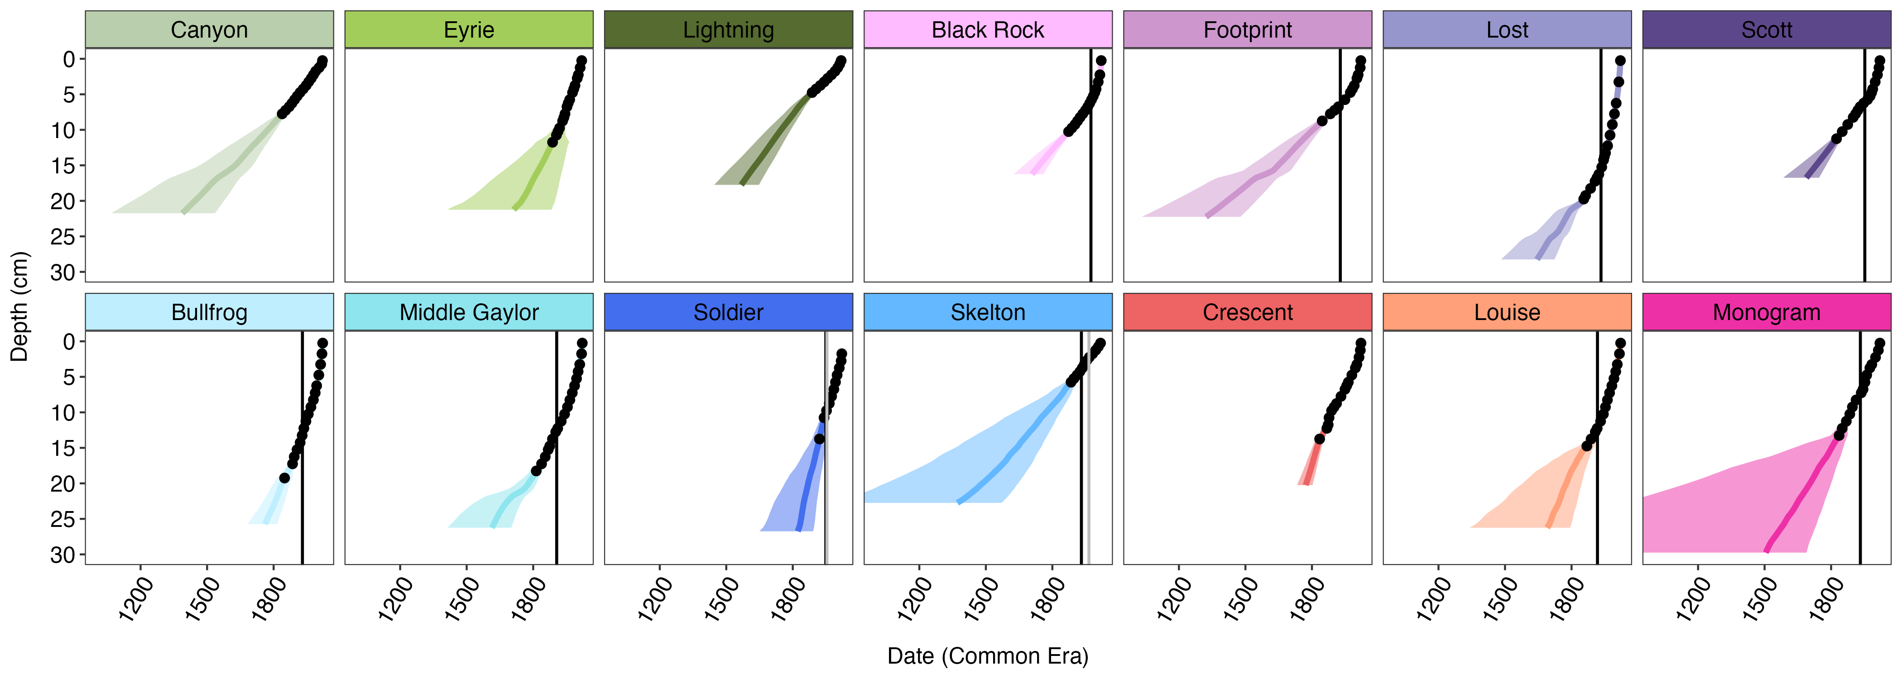
210Pb dates with fish disappearance/eradication

Slide 31
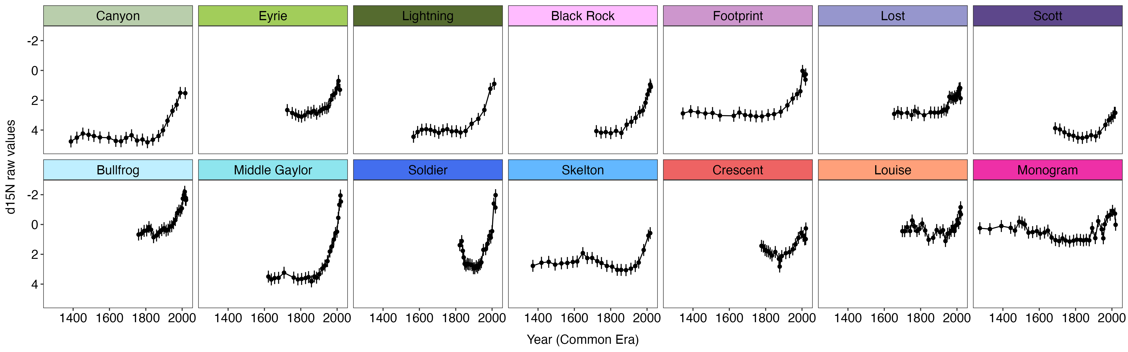
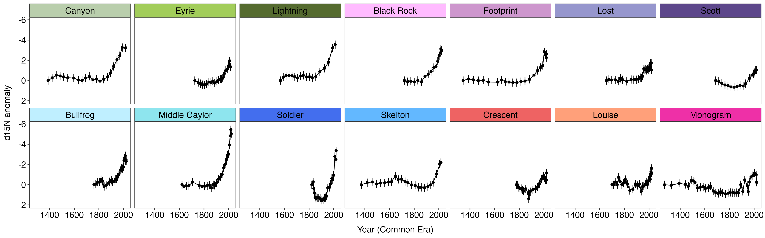
d15N
d15N anomaly
Notes:
Updated with LinCorr and not LinCorr d15N data

Slide 32
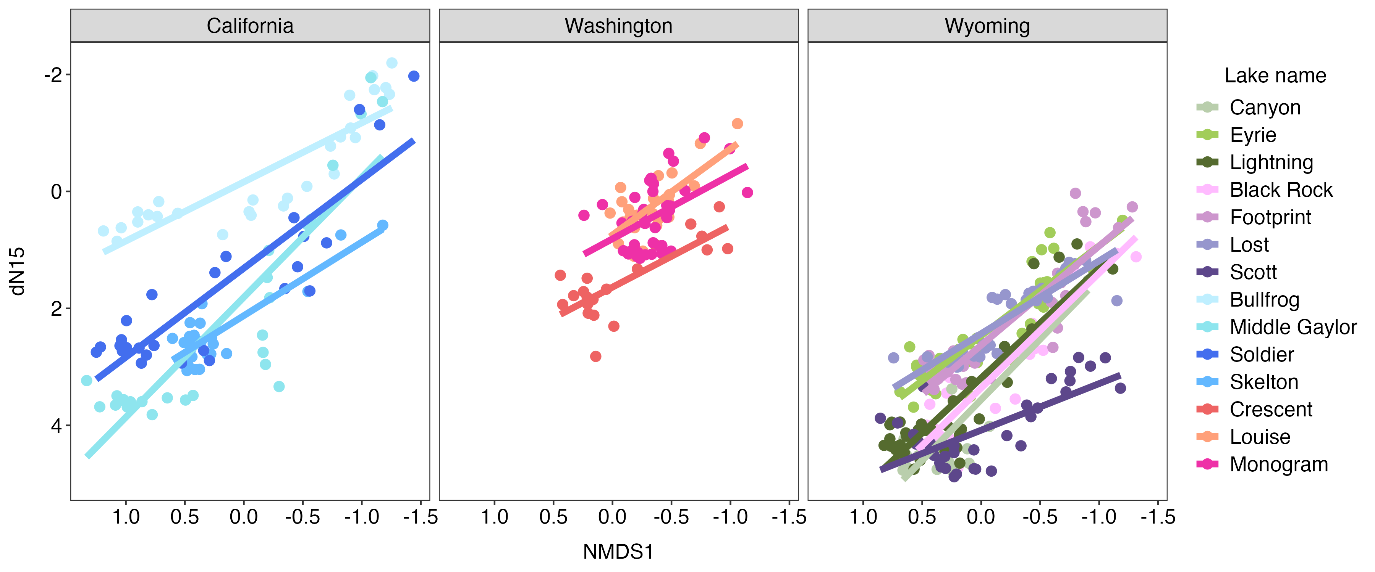
Nitrogen isotope ~ NMDS V7 phytoplankton

Slide 33
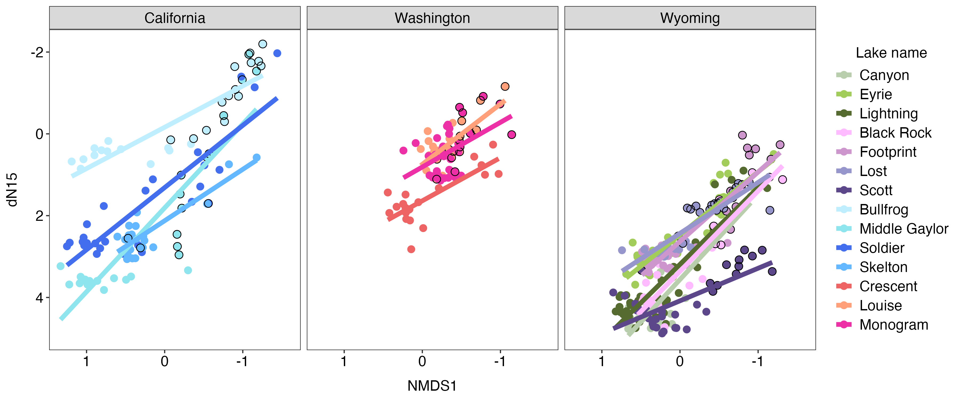
Nitrogen isotope ~ NMDS V7 phytoplankton – fish presence

Slide 34
Nitrogen isotope ~ NMDS V9 phytoplankton

Slide 35
Nitrogen isotope ~ NMDS V9 phytoplankton – fish presence

Slide 36
To do:
trophic mode assignment
relative abundances of phytoplankton
look into absolute values of N deposition in the 3 regions, 6 areas
N deposition (d15N) split by region and sample in 50 year time steps with uncertainty and see if different (split Wyoming into two).
Anomaly of dN15 for NMDS~dN15 and make three panel plot of CA/WA/WY with the regression lines on top
did we just want phytoplankton? Yes for now
do we want samples with fish highlighted?
In 210pb plot, light gray line for fish disappearance or removal
NMDS rotation (varimax)
ANOVA of NMDS scores with category of fish/fishless, high verses low dn15, pre and post 1960
Phytoplankton NMDS have a high dN15 panel and a low dN15 panel
blast for zooplankton

Slide 37
Questions:
- Include rotifers in zooplankton?

Slide 38
Suggestion on a forum:
test.data <- Harman74.cor$cov #twenty four mental measurements harm.dist <- sqrt(2*(1- test.data) ) #convert correlations to distances harm.iso <- isoMDS(harm.dist,k=2) # find the multidimensional solution harm.varimax <- varimax(harm.iso$points) #rotate with varimax op <- par(mfrow=c(1,2)) plot(harm.iso$points, main="unrotated") plot(harm.varimax$loadings,main="rotated")
-I could try a different type of transformation if there are a ton of zeros.
-I could look at the input and see if there are a lot of taxa that are low abundance and should be removed.
-I could remove unassigned taxa
Suggestions from ChatGPT
Principal Component Analysis (PCA) on NMDS Scores: If you want a sense of the overall variance structure or want to compare the NMDS configuration to something like a PCA, you can perform PCA on the NMDS scores themselves. This can help optimize for variance and provide insight into patterns in the data.
Rotate NMDS using external environmental variables: If you are interested in aligning the NMDS configuration with some environmental gradients, you can try rotating the solution in a way that better aligns with your variables. One way is using envfit from the vegan package to fit environmental variables onto the NMDS ordination and explore whether a specific rotation could help with interpretation.

